Slide 1
FPU Command Staff Course
1
Course Introduction

Slide 2
Aim
The aim of this lesson is to introduce participants, facilitators, and the course materials.

Slide 3
Relevance
As participants in this course, you have a responsibility to actively participate in all discussions, presentations and activities.
Familiarization with course materials and logistics will support your participation.

Slide 4
Learning Objectives
At the end of this lesson, you will be able to describe the course purpose and logistics

Slide 5
Lesson Overview
Introductions
Course purpose
Training Materials and Resources
Peacekeeping environment today
Course logistics
Assessments

Slide 6


Introductions
Name and title
Experience
Position in command staff
Course expectations

Slide 7
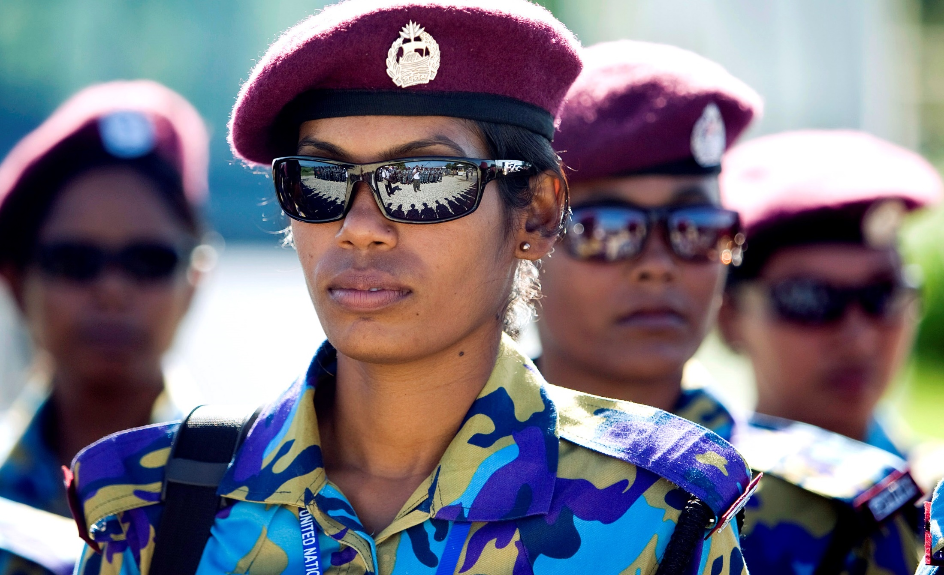
Course Purpose
  Prepare command staff to effectively lead Formed Police Units (FPUs) in the United Nations mission environment

Slide 8
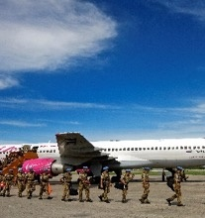
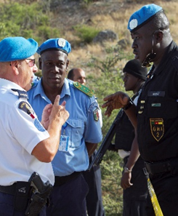
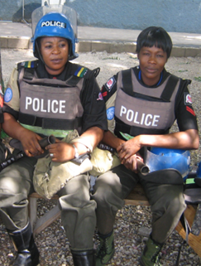
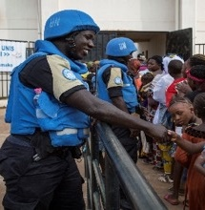
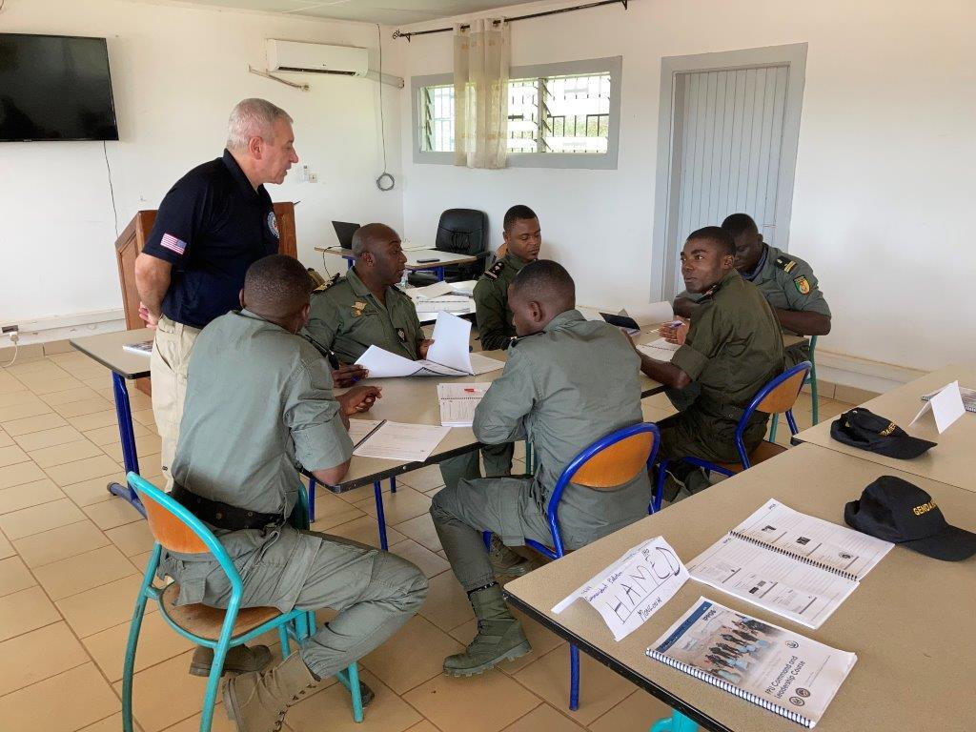



Course Map
(Proposed):
Time
12h 10m
Time
14h 20 m
Time
14h 30m
Time
6h
Time
9h
Fundamental introduction to UN, UNPOL and FPU
Command and leadership skills
Leading UN Principles and Strategy
Mission Readiness
Capstone
Leadership
7

Slide 9
Training Materials and Resources
Icons help you navigate the course materials
  Workbook
  Resource
  Guide
  Notes
  Self-Study

Slide 10
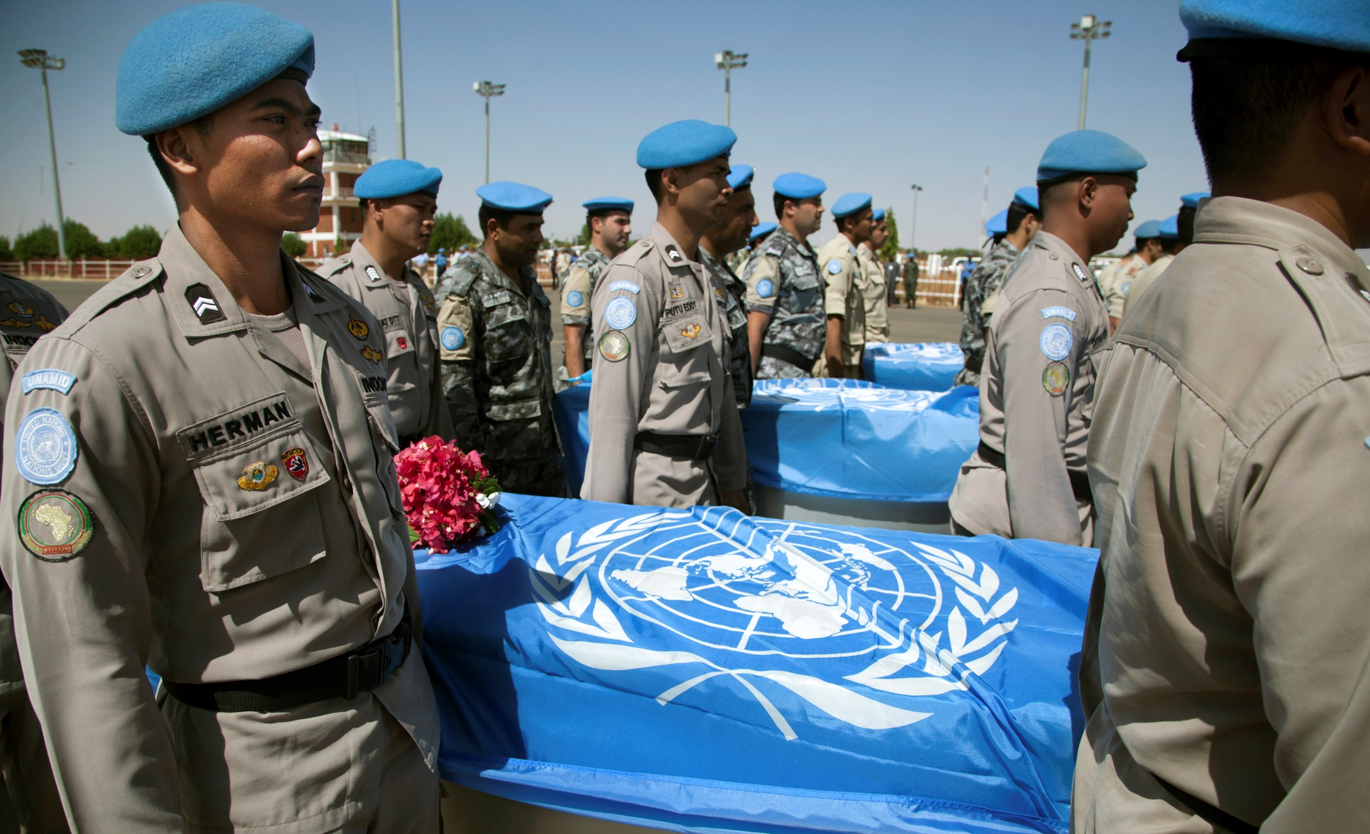
Peacekeeping Environment Today
Increasing casualties
Armed groups, terrorists, organized crime, street gangs, criminal and political exploitation
UN flag and blue helmet do not guarantee protection

Slide 11
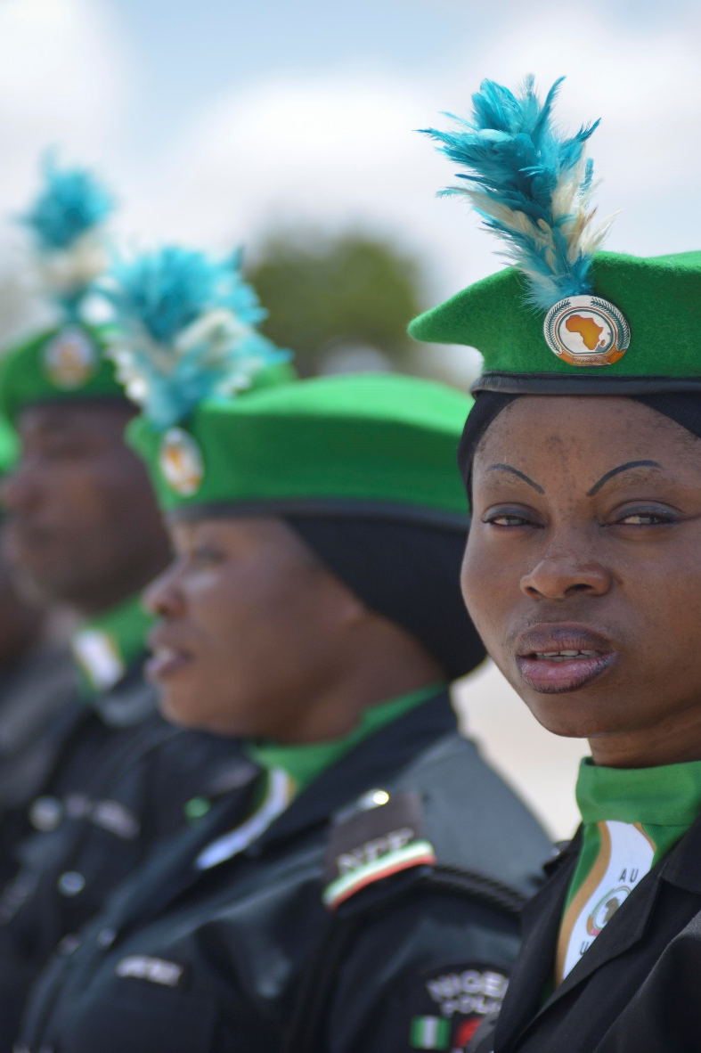
Adapting
New Peacekeeping Environment
Strengthen leadership at all levels
Promote initiative, commitment, and determination to adapt
Base operational behavior on a risk assessment specific to the situation

Slide 12
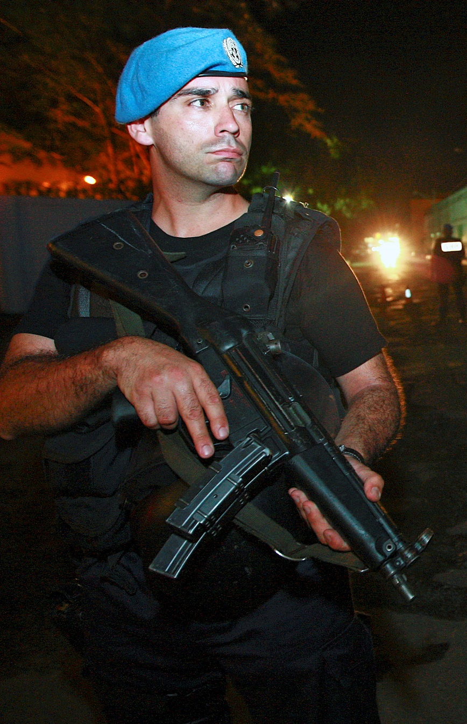
Adapting
New Peacekeeping Environment
Identify threats
Use mandates and directives on the use of force to take action, not to justify inaction
Gather and use tactical intelligence
Train, train, train

Slide 13
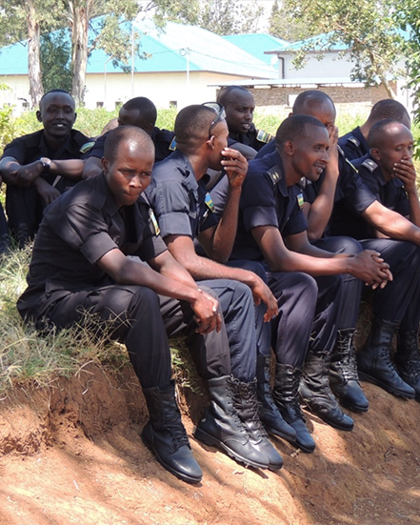
Course Logistics
  Daily schedule
  Breaks and lunch
  Course ground rules

Slide 14
1.1
Pre-Course Assessments
Complete the assessments as directed.
Pre-Course Knowledge Assessment
Readiness Self-Evaluation
Pre-Course Scenario Assessment (following slide)
Pre-course assessment scores are used as a baseline for comparison to post-course assessments. This helps assess course effectiveness.
Total: 1 Hour
Pre-Course Knowledge = 20 minutes
Readiness = 10 minutes
Scenario = 30 minutes

Slide 15
Pre-Course Scenario Assessment
You are the commander of FPU 1 in Galasi. You receive a call from the mission's FPU coordination asking you to immediately deploy a platoon to deal with a spontaneous demonstration.
  What are your first decisions?
Once you arrive at the scene, one of the FPU elements decides on his own to use tear gas against the crowd, feeling in danger.
  What action do you take immediately? Back at the camp?
The local police violently assault the calm crowd. You learn from the mission that this is not the first time and that they are used to doing this at every demonstration, and that they violate the rights of the people most of the time. Some demonstrators are injured and bleeding.
  What do you do?

Slide 16
Questions
Any questions or observations?

