Slide 1
FPU Command Staff Course
2
Overview of the UN

Slide 2
Aim
To provide an overview of United Nations peacekeeping, field missions and the mandate of the United Nations Police

Slide 3
Relevance
FPU command staff must have a general understanding of how peace operations are established in the UN in order to effectively deploy and carry out their missions.

Slide 4
Learning Objectives
Explain the United Nation’s purpose and goals
Differentiate between UN operations at the strategic, operational and tactical levels
Identify how the UN framework applies in missions

Slide 5
Lesson Overview
Introduction to the UN
UN peacekeeping at the strategic, operational and tactical levels
Presentation of the UNAC (Carana) mission mandate

Slide 6
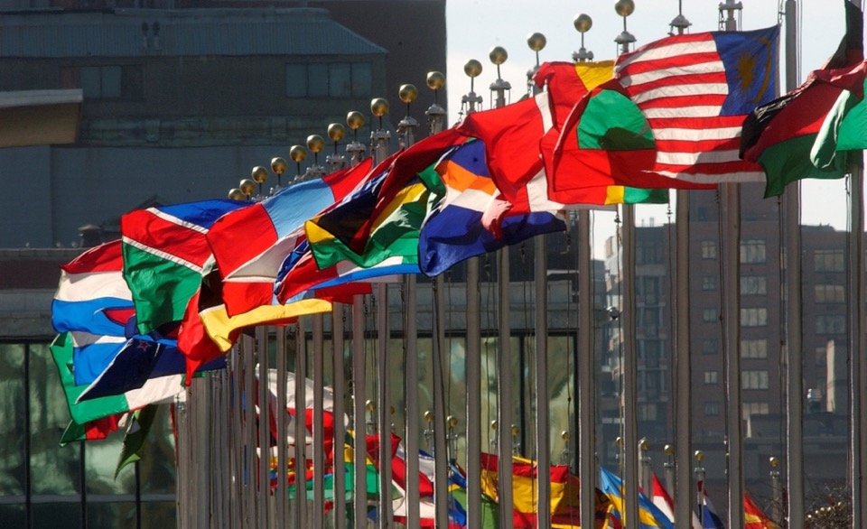
Purpose of the UN
What is the purpose of the UN?

Slide 7
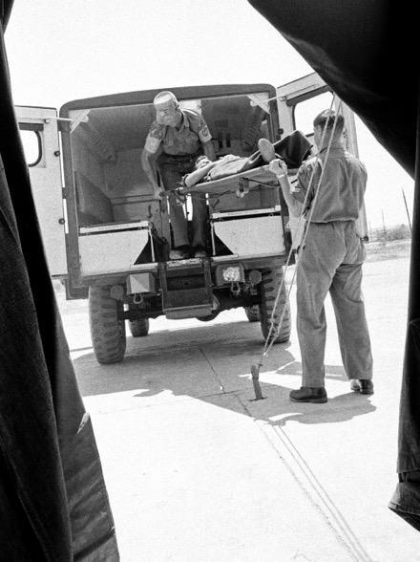
Purpose of the UN
Signed on 26 June 1945, in San Francisco, United States
193 sovereign Members States
    Maintain international peace and security
    Develop friendly relations among nations
    Promote social progress and better living standards
    Promote human rights
Notes:
Photo: UN Photo/G

Slide 8
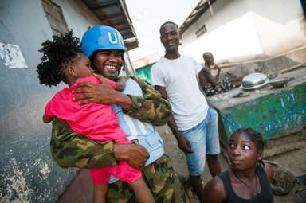
Strategic Peacekeeping Goals
1. Support Political Processes and Peace Agreements
2. Protect Civilians under Threat of Physical Violence
3. Strengthen National Capacities for Sustainable Peace
4. Facilitate the Delivery of Humanitarian Assistance
5. Promote and Protect Human Rights
6. Support Ceasefires and Reduce Violence

Slide 9
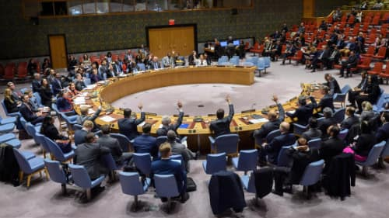
UN Security Council
Responsible for maintaining peace and security
May investigate and recommend peaceful solutions to disputes between Member States

Slide 10
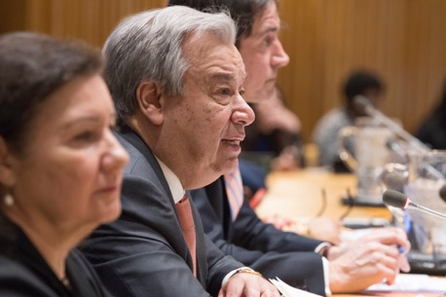
Secretary-General and Secretariat
The Secretary-General is the chief administrative officer
The UN Secretariat is the administrative arm of the UN
Ensure implementation of the SC resolutions
Delegates authority to the Under-Secretary General of DPO to set up the peacekeeping mission
Notes:
Photo: UN Photo/Eskinder Debebe

Slide 11
Linkages and Overlaps in Peace and Security Issues
Conflict Prevention
Conflict
Peace Enforcement
Peacemaking
Cease-fire
Peacekeeping
Post-Conflict Peacebuilding and Preventing Relapse into Conflict
Political process

Slide 12
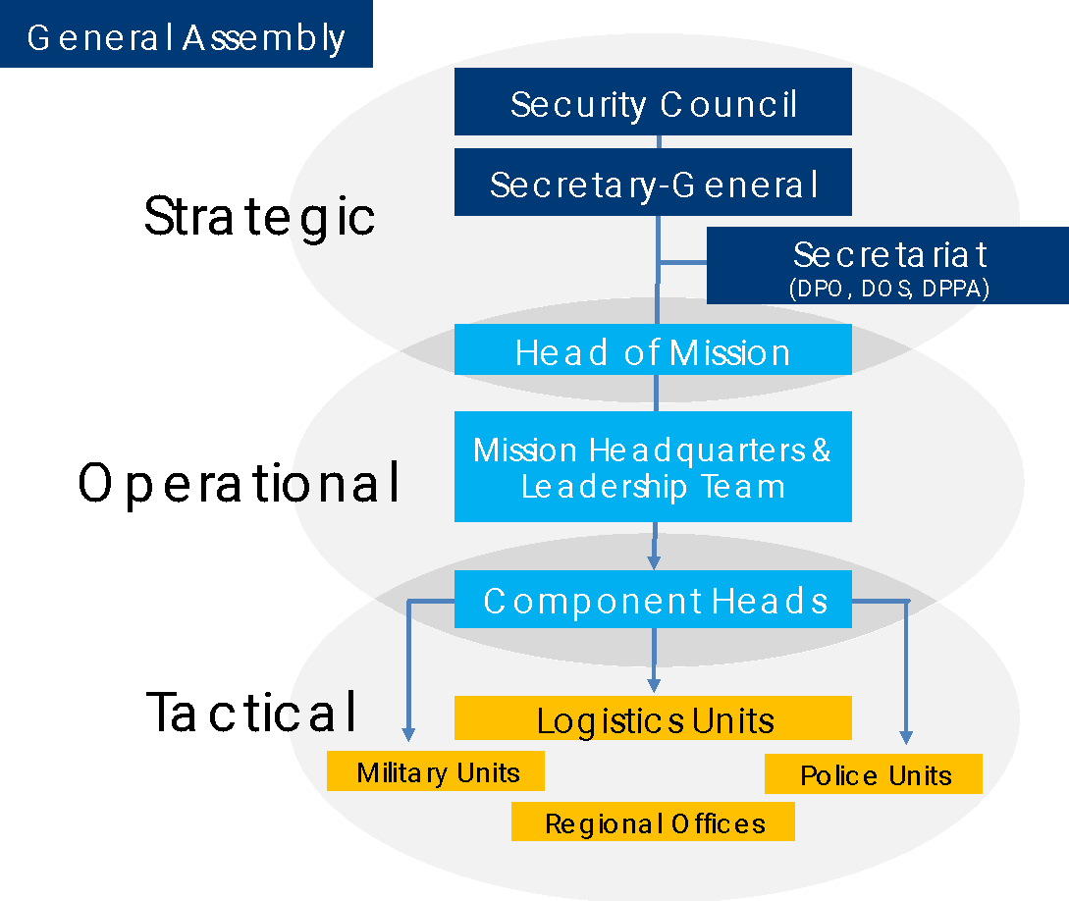


Peace Operations Components
DECIDES
IMPLEMENTS
USGDPO/USGDOS/USGDPPA
MILITARY ADVISER
POLICE ADVISER
UN AUTHORITY IN THE FIELD
OVERSIGHT HOPC AND HOMC
Military Units
Police Units
Regional Offices

Slide 13
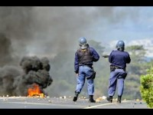
Carana Country Profile

Slide 14
2.1
Mission Mandate
Work in groups
Identify main task for the UN FPU referring to the UNAC Security Council Resolution 1544
Workbook 2.1: UNAC Mandate of the SCR 1544
Time: 30 Minutes
15 minutes brainstorming
15 minutes plenary

Slide 15
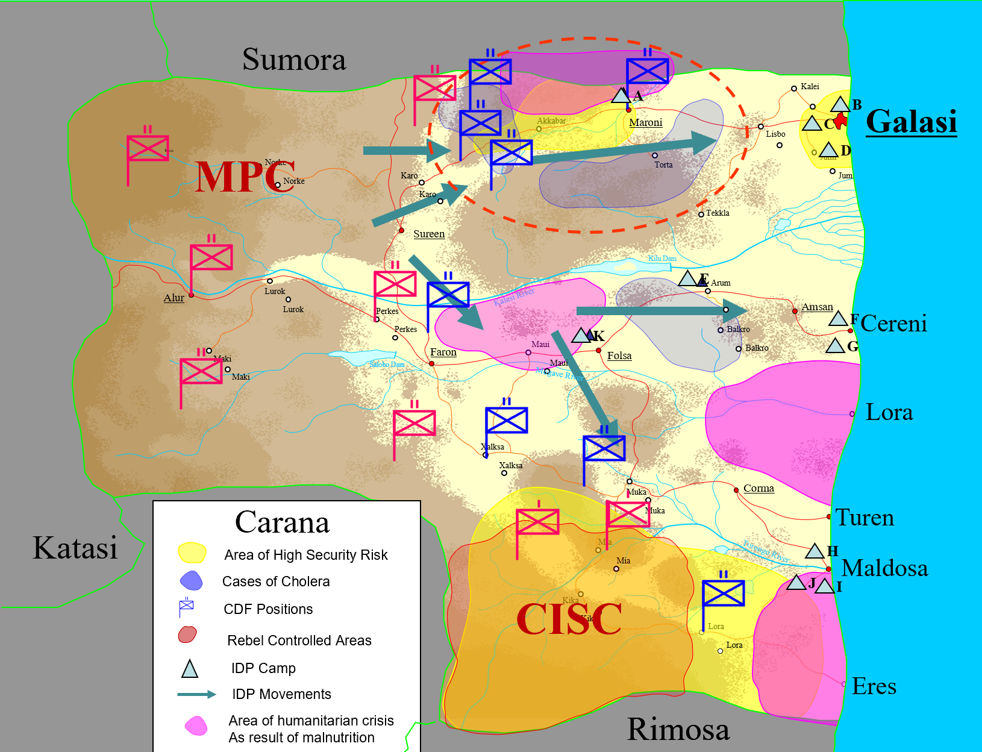
Debrief: UNAC Mandate SCR 1544
UNAC Mandate (SCR 1544)
  Support for implementation of the ceasefire agreement
  Support for disarmament, demobilization and reintegration
  Protection of Civilians and UN personnel and facilities
  Promotion and protection of human rights
  Facilitation of humanitarian assistance
  Support for security sector reform
  Support for implementation of the peace process (securing elections)

Slide 16
Debrief: FPU Main Tasks in UNAC
Providing UN convoys
Providing SWAT teams or units
Conducting high-visibility patrols with host-state law enforcement officers
Providing close protection for national officials
Providing a formed response for crowd control
Evacuating UN staff personnel

Slide 17
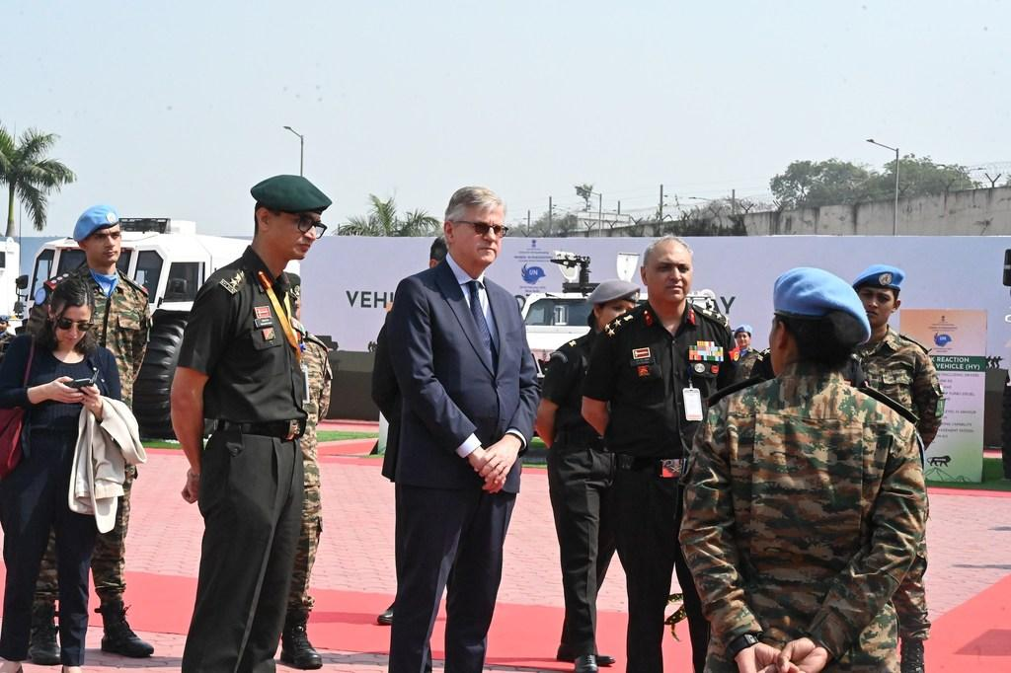
Department of Peace Operations
Provides guidance and support on military, police, mine action and other relevant issues to other UN political and peacebuilding missions
Supervises UNPOL selection, recruitment and deployment
Coordinate with Department of Operations Support for the deployment of FPUs
Notes:
Photo: UN Photo/Loey Felipe

Slide 18
UN Department of Political and Peacebuilding Affairs(DPPA)& Department of Peace Operations(DPO)Organizational Structure
Office of the
Under-Secretary-General
(DPPA/OUSG)
ASG for Middle East, Europe,
Americas, Asia-Pacific
Office of the
Under-Secretary-General
(DPO/OUSG)
Office of ASG for Middle East, Europe, Americas, Asia-Pacific
Office of ASG for Middle East, Europe, Americas, Asia-Pacific
Middle East Division
Asia Pacific Division
Security Council Affairs Division
Europe and Central Asia Division
Americas Division
Office of Rule of Law and Security Institutions
Office of ASG for Africa
Office of ASG for Africa
ASG for Africa
Electoral Assistance Division
Western Africa Division
Central and Southern Africa Division
Mine Action Service
Northern Africa Division
Eastern Africa Division
Police Division
Office for Coordination and Shared Services Office of the ASG for Peacebuilding and Peace Support
Policy and Mediation Division
Office for Coordination and Shared Services Office of the ASG for Peacebuilding and Peace Support
Office of the ASG for Peacebuilding and Peace Support
Office of Military Affairs
Division for
Palestinian Rights
Office for Coordination and Shared Services
Policy,Evaluation and Training Division
Decolonization Unit
Gender Unit
Office of Peacekeeping
Strategic Partnerships

Slide 19
Police Division (PD)
Police Adviser
(Director of Police Division)
In UNHQ New York, US
In UNLB Brindisi, Italy
Selection and Recruitment Section (SRS)
UNPOL selection and recruitment
Standing Police Capacity
(SPC)
Start-up phase and support of a peacekeeping mission
Mission Management and Support Section (MMSS)
Provides oversight, guidance and support
Strategic Policy and Development Section (SPDS)
Develops strategic documents

Slide 20
United Nations Police – Key Milestones
Implementation of
SGF and ”Improving Security of United Nations Peacekeepers”（Cruz Reports）reports published
Idea of a UN police service proposed
First official UNPOL component (Cyprus)
UNPOL passes 1,600 officers
Brahimi Report reforms peace ops
UNSC adopts first police resolution
1948
1960
1964
1989
1994
1999
2000
2005
2014
2015
2017
2024
First UN police deployed (Congo)
Major expansion of UNPOL missions
First Formed Police Units deployed
Standing Police Capacity created
HIPPO report
”The Future of Peacekeeping,
New Models, and Related
Capabilities” report published

Slide 21
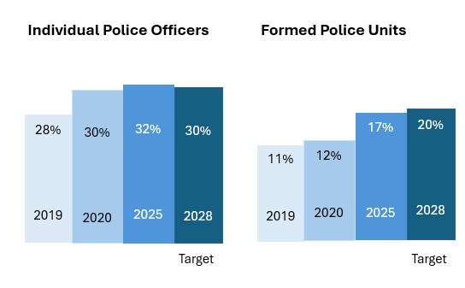
Women in UN Police

Slide 22
Summary of Key Messages
The United Nations was founded to maintain international peace and security.
The UNPOL mission is to support Member States in crisis situations to realize effective national police services that serve and protect the population.

Slide 23
Self-Study
  On your own time, review:
  DPKO/PD Directive for Heads of Police Components of PKO (2006.25)
  DPKO/DFS Guidelines on Police Command in United Nations Peacekeeping Operations and Special Political Missions (2015.14)
  DPKO/DFS Guidelines on Police Operations in United Nations Peacekeeping Operations and Special Political Missions (2015.15)
  DPO/DOS Policy on Authority, Command and Control in United Nations Peacekeeping Operations (2019.23)
  UN Peacekeeping Operations Principles and Guidelines, also known as the Capstone Doctrine, 2008

