Slide 1
FPU Command Staff Course
3
Overview of UN Police

Slide 2
Aim
Provide an overview of the organization and roles of UN Police (UNPOL) – Individual Police Officers (IPOs) and Formed Police Units (FPUs)

Slide 3
Relevance
United Nations Police Peacekeeping differs fundamentally from domestic policing.
This special context requires UN Police to understand the role of UNPOL in UN Peacekeeping and the guiding principles to follow.

Slide 4
Learning Objectives
Describe the mission and core functions of UN police
Identify how FPUs are generated
Describe and differentiate between the core functions of IPOs and FPUs
Discuss the elements of the Strategic Guidance Framework (SGF)
Define definition, composition and core function of FPUs
Explain the command, control and coordination relationship

Slide 5
Lesson Overview
Police peacekeeping mission and functions
Process for generating and deploying FPUs
IPO activities
The Strategic Guidance Framework and UNPOL
FPU definition
FPU core functions
Presentation of the UNAC mission police CONOPs
FPU command and control terms

Slide 6
Police Division (PD)
Police Adviser
(Director of Police Division)
In UNHQ New York, US
In UNLB Brindisi, Italy
Selection and Recruitment Section (SRS)
UNPOL selection and recruitment
Standing Police Capacity
(SPC)
Start-up phase and support of a peacekeeping mission
Mission Management and Support Section (MMSS)
Provides oversight, guidance and support
Strategic Policy and Development Section (SPDS)
Develops strategic documents

Slide 7

SRS: FPU Deployment/Rotation Process Overview
1
UN PCRS
2
Planning
Strategic Engagement
3
PCC Selection and Recruitment
4
Pre-Deployment
5
Deployment

Slide 8
3.1
FPU Deployment/Rotation Process
Review the chart in the workbook and place the steps in the correct order.
Workbook 3.1:
FPU Deployment/
Rotation Process
Time: 20 minutes
10 minutes activity
10 minutes debrief

Slide 9
Debrief:
FPU Deployment/Rotation Process
Question
1 | Pledge and Register in UN PCRS
2 | Assessment and Mission Planning
3 | UN – MS Dialogue on Potential Contributions
4 | Security Council Resolution Peacekeeping Mission
5 | Development of Mission / Police Support Concepts: CONOPS, DUF, SUR…
6 | Identification and Selection of PCCs Through PCRS
7 | PCC Conducts Reconnaissance Visit to the Mission
8 | Training and Verification – Formed Police Units
9 | MOU and LOA Negotiations
10 | Pre-deployment Visit (PDV)
11 | MOU and LOA Finalization
12 | TCC/PCC Provides Final Cargo Load List
13 | Movement of Personnel and COE to the Mission Area

Slide 10
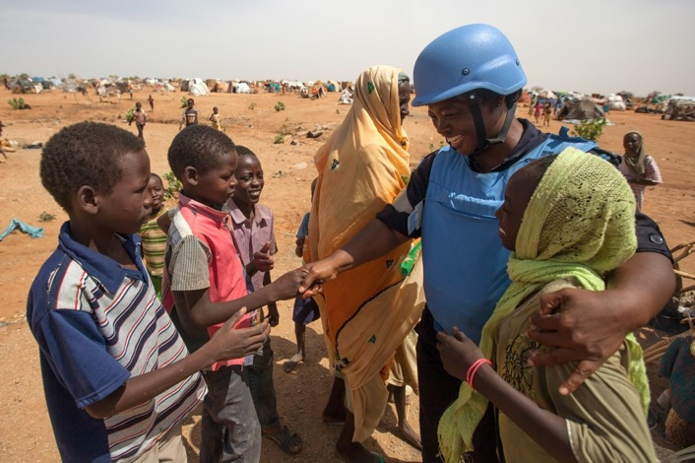
UNPOL Mission
  Enhance international peace and security by supporting Member States in conflict, post-conflict, and other crisis situations to realize effective, efficient, representative, responsive, and accountable police services that serve and protect the population.
Notes:
Photo: UN Photo/Albert Gonzalez Farran

Slide 11

UNPOL Statistics
4600+/7740
UNPOL
Officers
UN Police Division
80+
Contributing Countries
14
UN Peace Operations
22%
Female
Officers
* As of Jan 2026
2028 Target:
Female Officers
30%

Slide 12
Categories of UN Police Personnel*
Specialised Police Teams (SPTs)
IPOs, including all categories
FPUs
* In percent of all deployed UNPOL officers. As of December 2025.

Slide 13

Core UNPOL Tasks
The “what” UNPOL are expected to do
Capacity-Building and Development
Reform, Restructuring and (Re) Building
Operational Support
Interim Policing & Law Enforcement
~2014 Policy on the United Nations Police

Slide 14
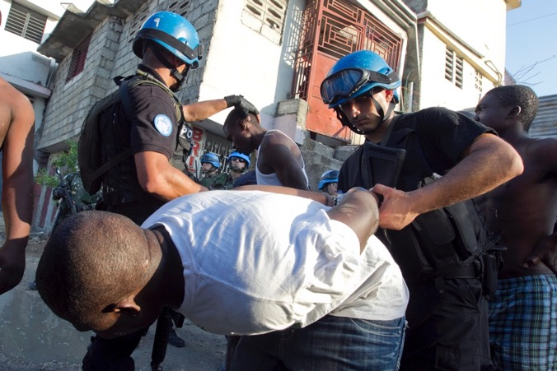
Core UNPOL Tasks:
Operational Support
Protection of civilian
Patrolling
Apprehension and detention
Transition and support
Public order management
Capacity-building, mentoring, and training
Notes:
Photo: UN Photo/Victoria Hazou

Slide 15
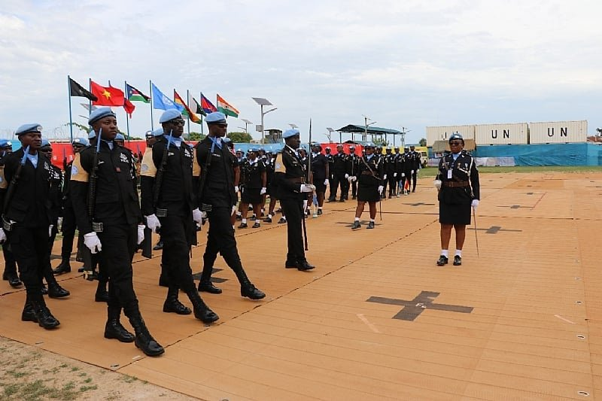
Core UNPOL Tasks:
Capacity-Building & Development
Legislation, systems, procedures, codes, and values
Organization, management, vetting, and training
Basic material, logistics, and communications
Notes:
Photo: UN Photo/Isaac Billy

Slide 16
SPDS: Mission and Police Support Concepts
DPO/mission level:
Mission concept
Police Division/mission level:
Police CONOPS
Directive of Use of Force
Operational Plan
Everything must be in compliance with SGF

Slide 17
3.2
CONOPS
Work in groups.
Identify the main parts of the UNAC CONOPS.
Identify the main goal of the UN Police in Carana.
Workbook 3.2: UNAC CONOPS
Time: 30 minutes
15 minutes brainstorming
15 minutes plenary

Slide 18
Strategic Guidance Framework for International Policing
SGF Purpose: enhance the effectiveness of UN policing through more consistent and standardised approaches
Guidelines on Police Administration
Guidelines on Police Capacity-Building and Development
SGF
Policy on United Nations Police
Guidelines on Police Command
Guidelines on Police Operations
Shared
Understanding
Detailed Job
Descriptions
Standardised
Training
Monitoring
& Evaluation

Slide 19
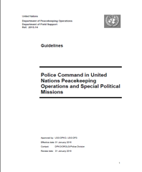
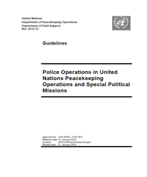
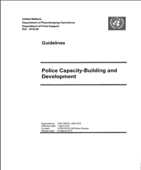


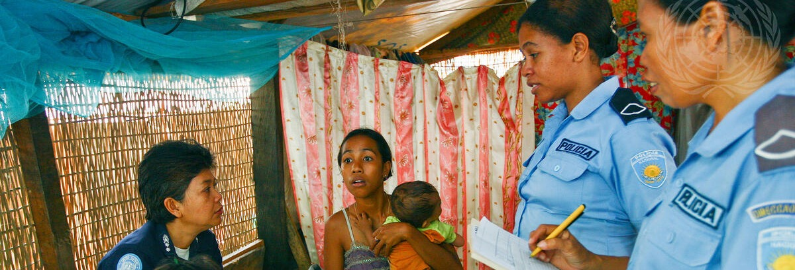


Strategic Guidance Framework
Notes:
Photo: UN Photo/Marco Dormino

Slide 20
Police Administration
Police Administration
Administrative systems
Budget management
Procurement
Record keeping
Personnel management

Slide 21
Capacity-Building & Development
Prepare officers and host-State institutions to ensure the long-term sustainability of international peace effort
Reform, rebuild, and restructure police and other law enforcement institutions in post-conflict and fragile states
Provide five key areas of support
  Support to police policy formulation
  Stakeholder engagement
  Support to police services
  Support to enabling services
  Support to accountability mechanisms
Police Capacity-Building & Development

Slide 22
Police Operations
Day-to-day UN police work, applying the basic principles of community-oriented and intelligence-led policing to carry out investigations
Provide public safety and conduct special operations
Police Operations

Slide 23
Police Command
Ensuring the appropriate resources, skills, capabilities and structures required to lead a complex, multidimensional peace operation
Planning, training initiatives & programs (i.e., POC), directing operations
Police Command

Slide 24
Example of Police Component Structure
HOPC
Deputy PC
Capacity Building & Development
Chief of Staff (Administration)
Deputy PC
Operations
Strategic Planning
Community Engagement
Monitoring and Evaluation
Project Oversight
Accountability
Public Affairs/Outreach
Focal Point: Logistics
Conduct and Discipline
Focal Point: Procurement
Human Resources
Focal Point:
Finance
ICT
Induction and Training
Records Management
Staff Welfare
Policing Services
Enabling Services
Policy Formulation on Policing
Accountability/
Governance
Stakeholder Engagement
FPU coordination office
Investigations
Special Operations
Community-Oriented Policing

Slide 25
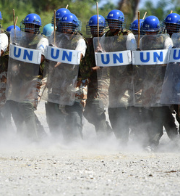
Definition of FPU
FPUs are defined as specialized, cohesive, armed mobile police units, providing security support to United Nations operations by protecting civilians; supporting as well as undertaking police operations that require a formed response; and ensuring the safety and security of United Nations personnel and assets.

Slide 26
Formed Police Units (FPUs)
Majority of police officers in UN peace operations
Trained and equipped to act as a self-sustaining, cohesive unit
Capable of accomplishing policing tasks that individual police officers could not address

Slide 27
Formed Police Units (FPUs)
Deployed under MOU between UN and PCC based on mission SUR.
Consisted of 160 members (Number of FPU vary according to mission SUR).
Formed entirely from one contingent
Not deployed to perform the functions of the military
Standard tour of duty is one year and should not exceed 18 months.
Other Capabilities (National Support Element, NSE) & Gender.
Trained and equipped to act as a self-sustaining, cohesive unit
Capable of accomplishing policing tasks that individual police officers could not address

Slide 28
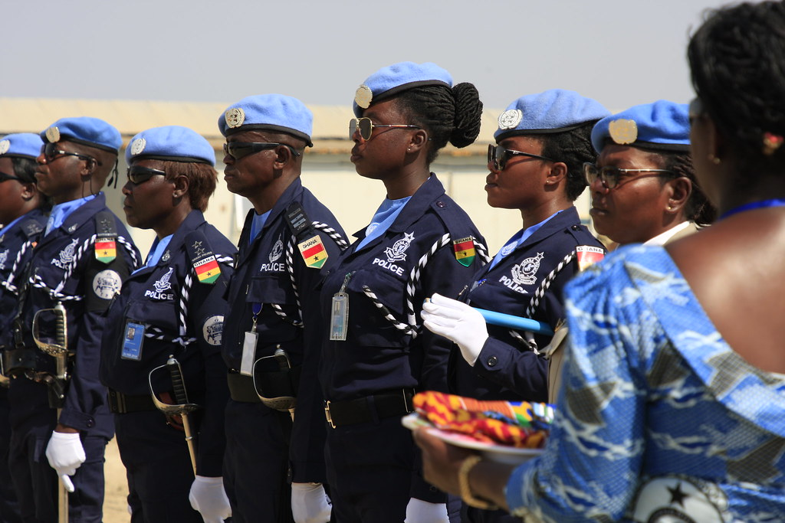
FPU Policing Expertise
Key Benefit to Formed Police Unit - armed, cohesive, specialized, mobile with policing expertise (POM)
Not a reserve labor force
Performance of core tasks essential for effectiveness
Notes:
UN Photo/Tieles

Slide 29
Operational Capacity
Deployed in interoperable tactical sub-units (platoons and sections)
Minimum number of platoons is four (approximately 32 officers each)
Operational personnel constitute a minimum 85% of the unit
Support personnel should not exceed 15% of the unit
Leave Percentage during deployment must not exceed 25% of the effective strength
Operational capacity
Command and operation component
Executive component

Slide 30
FPU Organization and Composition
Operational capacity
Command and operation component
Executive component
Logistics support component
Special components/ Embedded special units
(mission-specific)

Slide 31
3.3
FPU Policy and UNAC Mandate
Work in groups
Answer the questions on the FPU policy
    Identify the core and non-priority functions of the FPUs
Link the main tasks of the FPUs to the FPU core tasks and non-priority functions
Workbook 3.3: FPU Policy and Mission Mandate
Resource Guide: FPU Policy
Time: 40 minutes
20 minutes group activity
20 minutes plenary

Slide 32
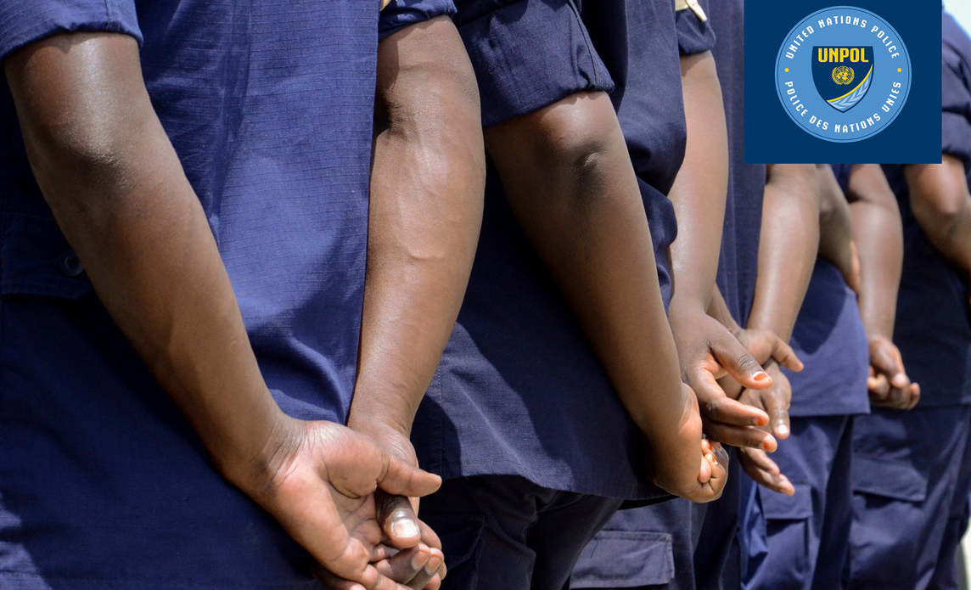
FPU: Core Functions
“How” FPUs contribute to the UNPOL Core Tasks
  Protect civilians from threats of physical violence
  Support and/or undertake police operations that require a formed response or specialized capacity above the capability of IPOs and/or Specialized Police Teams
  Protect United Nations personnel and property
Notes:
Photo: UN Photo

Slide 33
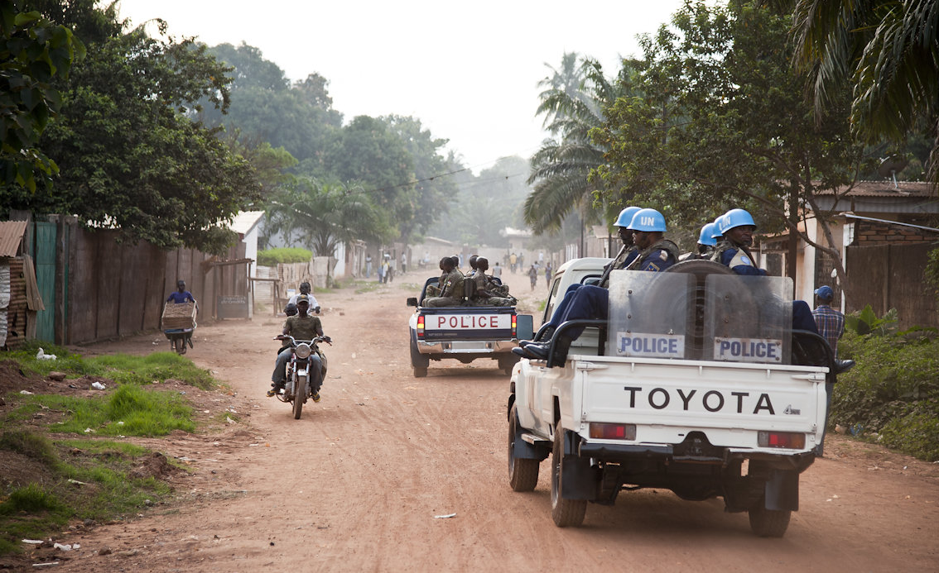

Protect Civilians from threats of physical violence
Formed response to threats to public order
Human rights standards
Operational support to host-State police
Deterrence
high-visibility patrols
Notes:
Photo: UN Photo

Slide 34
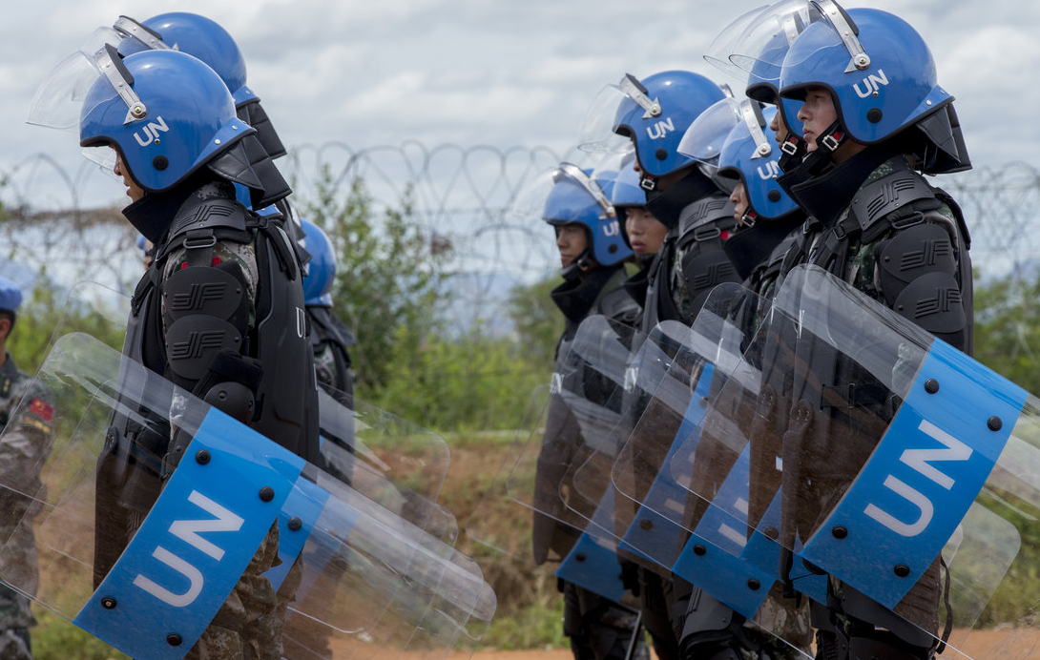
Support Police Operations
High-visibility and joint patrols
Public order management
Intervention and specific police tactics and techniques.
Notes:
Photo: UN Photo

Slide 35
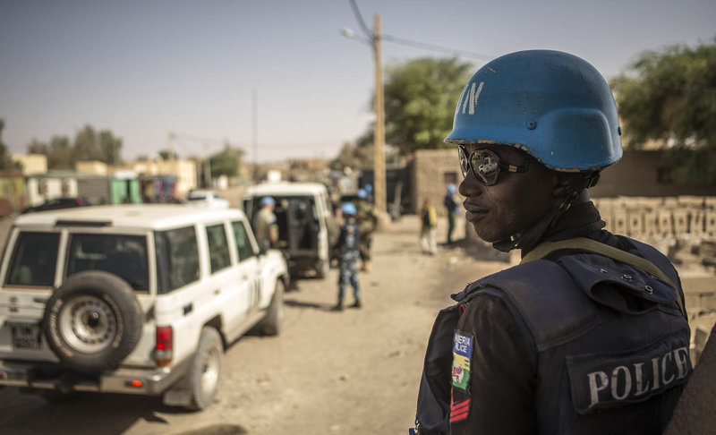
Protect UN Personnel and Property
Protection of convoys
Relocation or evacuation of staff
Intervention, where necessary, for the protection of staff and in accordance with FPU capabilities
Close protection and VIP escorts
Notes:
Photo: UN Photo

Slide 36
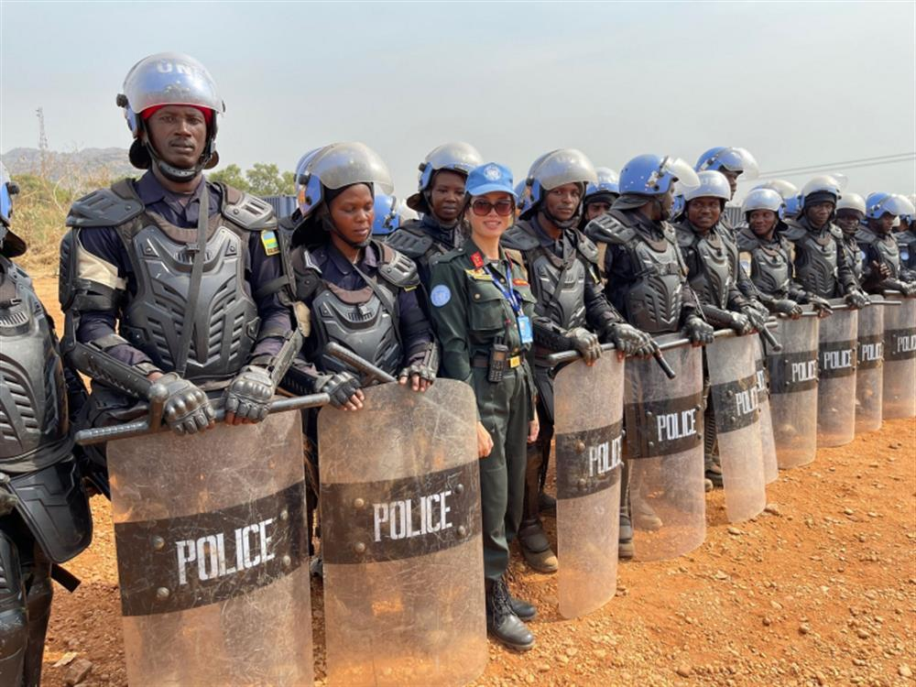
Capacity-Building
Not a core task for FPUs
Support by creating a safe environment for IPOs conducting CB
May participate in joint exercises and training with host-State police
Uphold UN standards – modeling the way
Notes:
UN Photo/Logan Abassi

Slide 37
Review
FPU Core Functions and Activities
FPU Core Functions
Protect UN personnel and property
Protection civilians from threats of physical violence
Support and/or undertake police operations that require a formed response or specialized capacity above the capability of IPOs and/or Specialized Police Teams
  FPU Activities
  Providing security to UN convoys
  Providing SWAT teams or units
  Conducting high-visibility patrols with host-State law enforcement officers
  Providing close protection for national officials
  Providing a formed response for crowd control
  Evacuating UN staff
  personnel

Slide 38
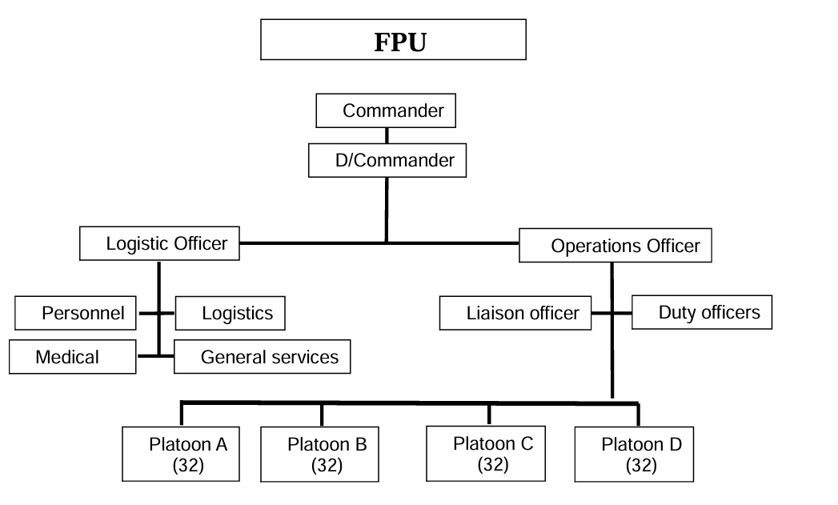
FPU Organizational Chart

Slide 39
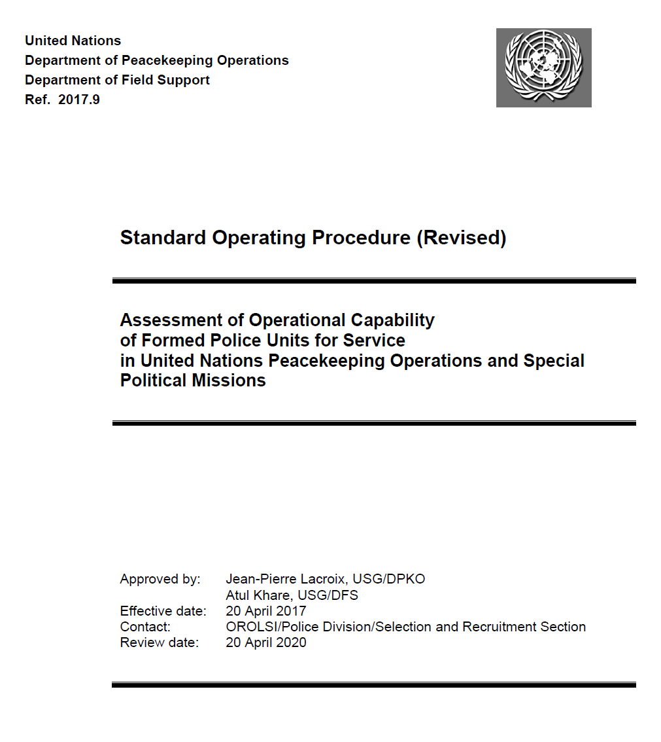

SOP on AOC
  Contains job competencies,
  descriptions, duties and responsibilities, and requirements
  Provides instructions and guidance for AOC
  Supports pre-deployment selection and training

Slide 40
Annex A
Outlines command staff positions:
  General competencies and skills
  Description
  Duties and responsibilities
  Requirements

Slide 41
3.4
Duties and Responsibilities in Mission
Use 3.4-1 to review the duties and responsibilities for command staff positions.
Use the matrix in 3.4-2 to identify who is responsible for the in-mission duties and responsibilities.
Work as a group to answer the questions.
Present your answers.
Workbook 3.4 Duties and Responsibilities
Time: 40 minutes
20 minutes group work
20 minutes plenary

Slide 42
IPOs and FPUs Working Together
FPUs support IPOs by providing formed, robust, and specialized policing capabilities in complex operational environments, including:
Operational Support to IPOs
Joint Capacity-Building and Training
Support to Investigations and High-Risk Tasks
Electoral Security and Democratic Processes
Joint and High-Visibility Patrols

Slide 43
What Level(s) are FPUs in UNPOL?
Tactical
Notes:
Photo: UN Photo

Slide 44
3.5
Command, Control and Coordination
Work in groups
Step 1: Explain the command, control and coordination relationship for FPUs. Present the results in plenary
Step 2: Complete the following table for the command structure for FPUs
Use the FPU policy to support your answers
Workbook 3.4: Command, Control and Coordination
Resource Guide: FPU Policy
Time: 40 minutes
20 minutes group activity
20 minutes plenary

Slide 45
Learning Activity 3.5
Command, Control and Coordination
One FPU
Sections or platoons from more than one FPU
More than one FPU
Operational
Command
HoPC
His or her delegate
Chief of operations
Deputy chief of operations
Regional commanders
Operational
Command
HoPC
His or her delegate
Chief of operations
Deputy chief of operations
Regional commanders
Operational
Command
HoPC
His or her delegate
Chief of operations
Deputy chief of operations
Regional commanders
MCP
MCP
Operational
Control
Operational
Control
Regional commander
Deputy chief operations
His or her delegate
Operational
Control
Regional commander
Deputy chief operations
His or her delegate
FPU commander
Tactical
Command
Tactical
Command
MCP
Tactical
Command
MCP
FPU commander
Deputy chief operations
His or her delegate
Deputy chief
operations
His or her delegate
Tactical
Control
Tactical
Control
Tactical
Control
FPU commander
FPU commander
FPU commander

Slide 46

Command and Control Terms
UN operational authority
Full Command
Operational control (OPCON)
Tactical command (TACOM)
Tactical control (TACON)
Police component (in case of joint operation)

Slide 47
Command, Control, and Coordination Models
FPUs are managed at the mission HQ level to be deployed throughout the mission area on demand
FPUs are assigned to an area of responsibility in accordance with a regional UN police structure and under the operational control of UN police regional commanders
Some FPUs in a mission area are distributed to police regions, while the remainder are managed at the mission HQ level

Slide 48
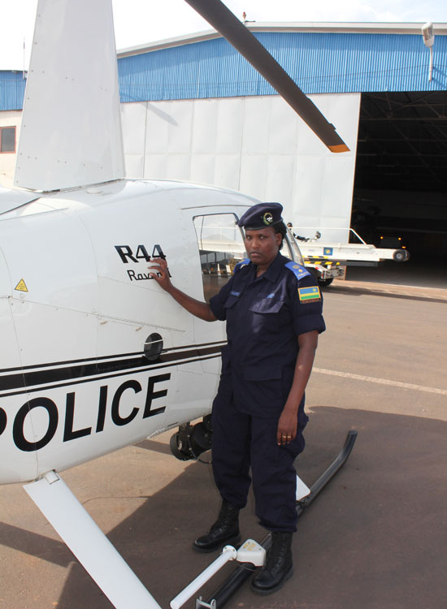
Command Positions
Know command, control, and coordination of FPUs in peace operations
React to and manage public order incidents
Mobile command post (see lesson on joint and combined operations)
Notes:
Photo: UN Photo

Slide 49
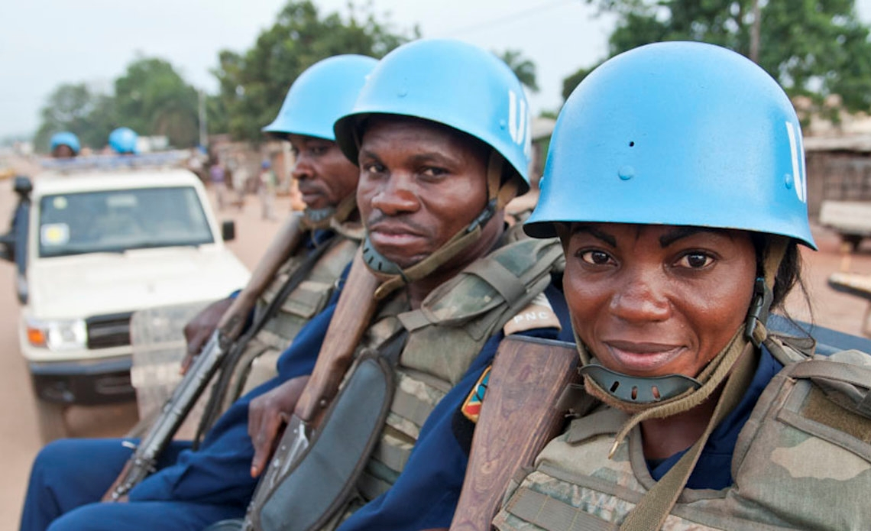
Women Officers: Operational Capacity
Operational impact
Prioritized for deployment
Notes:
Photo: UN Photo

Slide 50

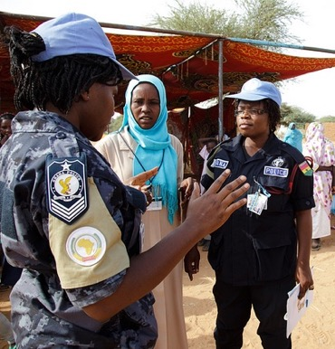
Discussion: Key Messages
Link to Leadership
How will you use the information in this lesson in your role as FPU command staff?

Slide 51
Self-Study
On your own time, review:
DPKO/DFS Guidelines on Police Command in United Nations Peacekeeping Operations and Special Political Missions (2015.14)
DPKO/DFS Guidelines on Police Operations in United Nations Peacekeeping Operations and Special Political Missions (2015.15)
DPKO/PD Guidelines for United Nations Police Officers on Assignment with Peacekeeping Operations (DPKO/PD/2006/00135) (revised forthcoming)
DPKO/DFS Policy (Revised) on Formed Police Units in United Nations Peacekeeping Operations (2024.14)

