Slide 1
Overview of United Nations Police (UNPOL)

Slide 2
Aim
To provide participants with a clear understanding of the mission and the mandate of United Nations Police (UNPOL)

Slide 3
Relevance
United Nations Police Peacekeeping differs fundamentally from domestic policing. This special context requires UNPOL to understand their role in UN Peacekeeping and which guiding principles to follow.
2

Slide 4
Learning Objectives
Learners will be able to:
Reflect how the work of UNPOL differs from domestic policing
Illustrate the mission and mandate of United Nations Police
Identify the core functions of UNPOL
Explain how UNPOL performance should reflect the principles identified in the Strategic Guidance Framework for International Policing (SGF)
3

Slide 5
Lesson Overview
Bridge-in learning activity
UNPOL mission and mandate
UNPOL at a glance
Strategic Guidance Framework (SGF) for International Policing
Coordination of UNPOL activities from UN Headquarters
Summary
4

Slide 6
Learning Activity: 1.1
Instructions
Discuss in your groups (10-15 minutes):
  How does domestic policing differ from international policing in a post-conflict context?
  How do you think your work in the mission will be different than what you do at home?
Record your answers on a flipchart paper.
Present your ideas to the plenary.

Slide 7
UNPOL Mission
The mission of the United Nations Police is to enhance international peace and security by supporting Member States in conflict, post-conflict and other crisis situations to realize effective, efficient, representative, responsive and accountable police services that serve and protect the population.
~2016 Report of the Secretary-General on United Nations Policing (S/2016/952)
6

Slide 8
UNPOL Mandate
Build and support, or, where mandated, act as a substitute or partial substitute for, host-State police capacity to prevent and detect crime, protect life and property and maintain public order and safety in adherence to the rule of law and international human rights law.
Pursue community-oriented and intelligence-led policing approaches to contribute to the protection of civilians and human rights; address, among other things, sexual and gender-based violence, conflict-related sexual violence and serious and organized crime; and conduct investigations, special operations and electoral security.
~2014 Policy on the United Nations Police

Slide 9

Core UNPOL tasks
Capacity-Building and Development
Reform, Restructuring and (Re) Building
Operational Support
Interim Policing & Law Enforcement
~2014 Policy on the United Nations Police

Slide 10
UN Police at a Glance*
11,458
94
16
15%
UNPOL authorized strength
Police Contributing Countries
UN Peace Operations with UNPOL deployment
Female percentage
* As of May 2021

Slide 11
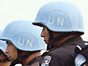
UN Police in DPO Missions
2,101
UNMISS
South Sudan
69
UNFICYP
Cyprus
12
MINURSO
Western Sahara
10
UNMIK
Kosovo
1
UNIFIL
1,920
MINUSMA
Mali
T O T A L
authorized:
10,773
640
UNISFA
Abyei
1,441
MONUSCO
D.R. Congo
2,080
MINUSCA
CAR
2,500
UNAMID
Darfur (Sudan)
May 2020
Formed Police Units
ENGLISH Language
FRENCH Language
Notes:
10

Slide 12
UN Police in Special Political Missions
5
UNSMIL
Libya
26
UNMAH
Yemen
21
UN Integrated
Office
in Haiti
60
UN Verification
Mission
in Colombia
T O T A L
authorized:
132
ENGLISH Language
2
UNIOGBIS
Guinea Bissau
18
UNSOM
Somalia
FRENCH Language
PORTUGUESE Language
May 2020
SPANISH Language
ARABIC Language

Slide 13
Categories of UN Police Personnel
Individual Police Officers on Secondment
Police Officers
Civilian Experts
Specialized Police Teams
Formed Police Units

Slide 14
Categories of UN Police Personnel*
SPTs
IPOs, including all categories
FPUs
* In percent of all deployed UNPOL officers. As of May 2021.

Slide 15
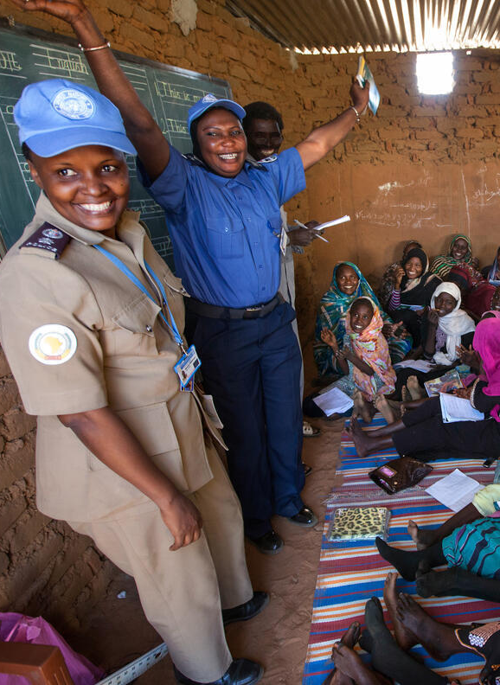
UNPOL - Towards Gender Equality
Gender mainstreaming
Police Division Gender Strategy
UN Police Gender Toolkit
UN Police Gender Advisers
1
2
3
Gender parity
2018
10%
2028
20%
Advocacy
  Seven International Female Police Peacekeeper Awards
  International Female Police Peacekeeper Network
  International Association of Women Police

Slide 16
Strategic Guidance Framework for International Policing
SGF Purpose: enhance the effectiveness of UN policing through more consistent and standardised approaches
Guidelines on Police Administration
Guidelines on Police Capacity-Building and Development
SGF
Policy on United Nations Police
Guidelines on Police Command
Guidelines on Police Operations
Shared
Understanding
Detailed Job
Descriptions
Standardised
Training
Monitoring
& Evaluation

Slide 17
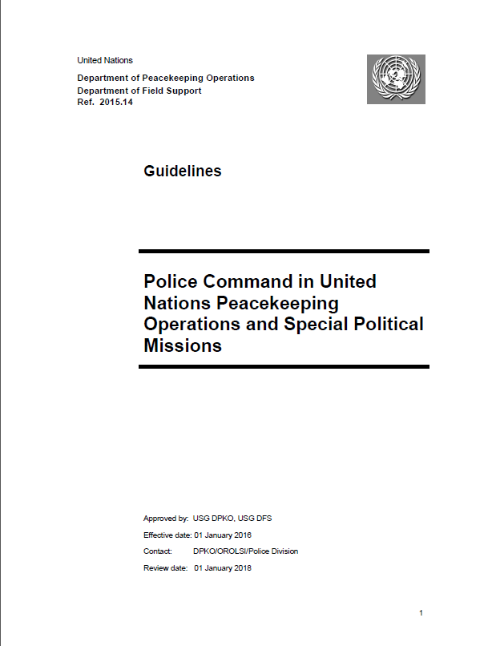
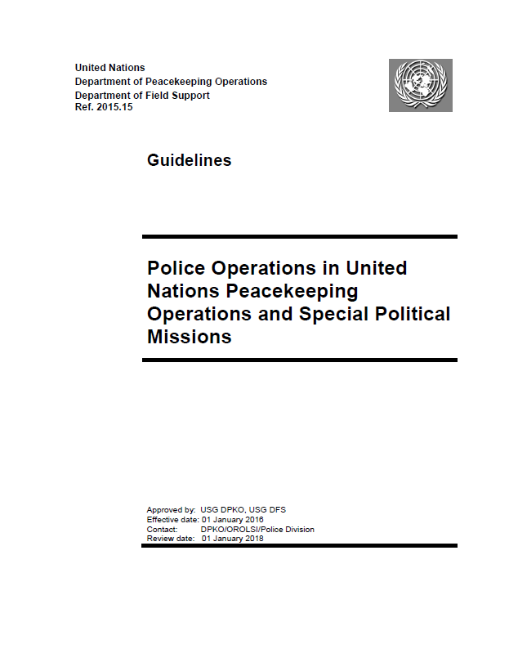
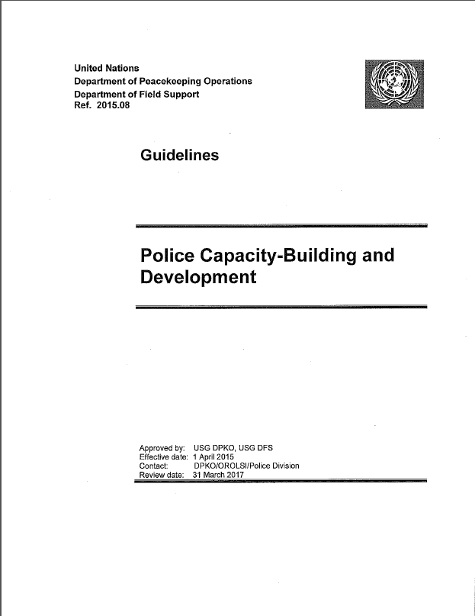
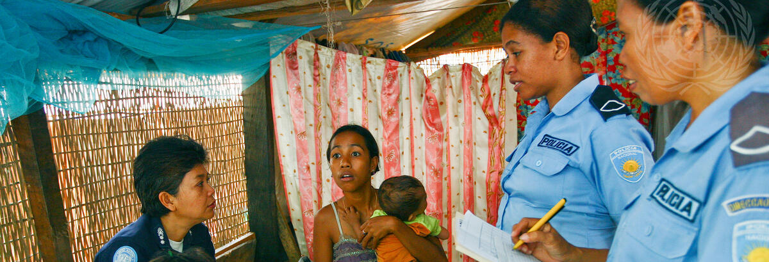
Strategic Guidance Framework

Slide 18
Department of Peace Operations
UNDER SECRETARY-GENERAL FOR PEACE OPERATIONS
OFFICE OF
MILITARY AFFAIRS
OFFICE OF RULE OF LAW AND
SECURITY INSTITUTIONS
POLICY EVALUATION AND
TRAINING DIVISION
OUSG DPO
Force Generation
Service
POLICE DIVISION
Best Practices Service
Integrated
Operational Teams
Current Military
Operations Service
JUSTICE &
CORRECTION
SERVICE
Integrated Training
Service
Peacekeeping
Strategic Partnership
Military Planning
Service
Evaluation
Team
DDR SECTION
Integrated Assessment
& Planning
Assessment Team
SSR SECTION
Partnerships
Team
Gender Unit
Policy &
Doctrine Team
MINE ACTION SERVICE
Strategic
Force Generation &
Capabilities Planning
Liaison Team

Slide 19
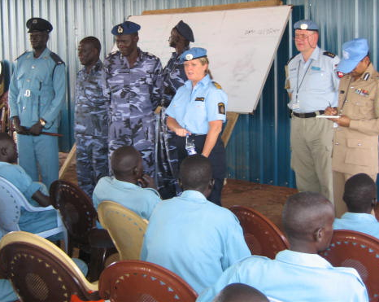
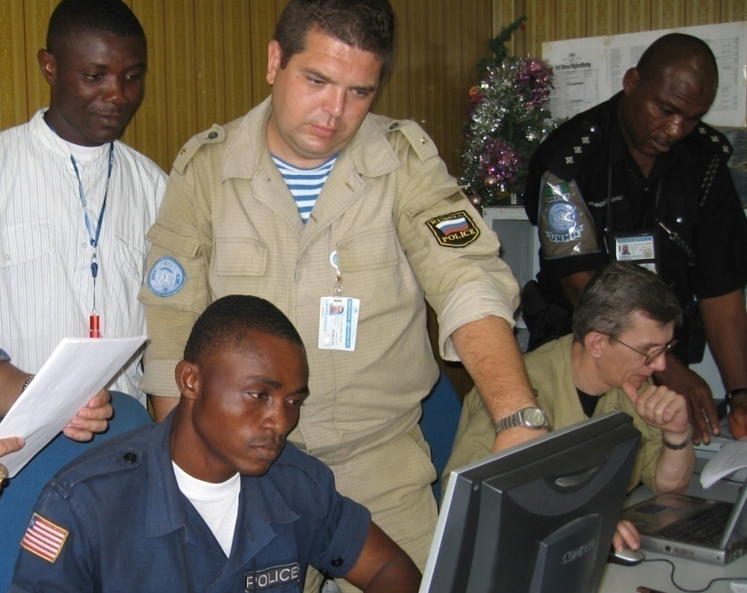
Police Division Core Responsibilities
Planning for the deployment of UN Police
Selection, recruitment, deployment and rotation of UN Police personnel
Development of policy and guidance
Operational support, strategic advice and guidance to field missions
Advocacy with Member States, partnership-building and strategic communication

Slide 20

Standing Police Capacity –
Core Functions
SPC Core Functions
SPC Strength and added-value (history)
Start-Up Capability
Advice, Expertise & Assistance

Slide 21
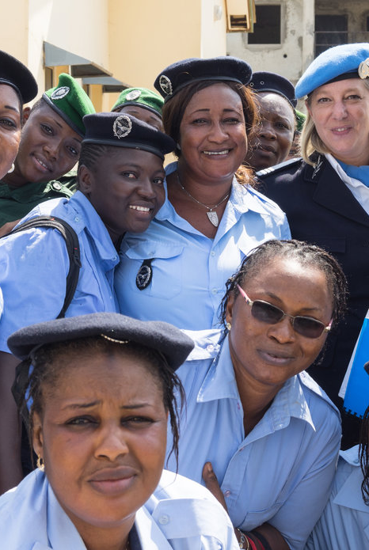
Coordination of Policing Activities in Host-States
UNPOL is the system-wide service provider and focal point on policing and other law enforcement matters
Global Focal Point arrangement for Police, Justice and Corrections areas in the Rule of Law in Post-Conflict and other Crisis Situations (GFP) allows United Nations entities to deliver as one

Slide 22
Summary of Key Messages
United Nations police peacekeeping differs fundamentally from domestic policing with regard to the context, authority, professional background and culture.
UNPOL mission is to support Member States in crisis situations to realize effective national police services that serve and protect the population.
UNPOL operates in accordance with the SGF. The SGF provides standardised approaches to the provision of public safety, police reform and support to national police and other law enforcement agencies.

Slide 23
Questions

