Slide 1
Use of Force and Firearms by UN Police

Slide 2
Aim
To provide an understanding of human rights implications related to the use of force by law enforcement officials

Slide 3
Relevance
As UNPOL, you must:
Have a clear understanding of human rights standards related to the use of force that:
  must be followed by UNPOL in its own operations, and
  guide UNPOL's monitoring, mentoring and advising for the host-State police
Take actions to prevent abuses
Follow procedures after force is used
2

Slide 4
Learning Objectives
Apply the principles on use of force based on the relevant international human rights standards
Explain the permissible circumstances and procedures for the use of force and/or firearms
Determine the appropriate means of force and/or firearms in different situations typical for Peace Operations
3

Slide 5
Lesson Overview
Definitions
Principles of use of force, including firearms
Use of firearms
UNPOL responsibilities
Use of force implications
Learning activity
4

Slide 6
Introduction
UNPOL’s use of force is based on the Security Council Mandate and the Status of Forces Agreement (SOFA)
The Police Concept of Operations (CONOPS) & Directives on Detention, Searches and Use of Force (DUF) spell out the authority to use force
UNPOL must respect international human rights and criminal justice requirements in the UNPOL Strategic Guidance Framework & mission DUF
UNPOL acts only in law enforcement paradigm

Slide 7
Scenario 1
A Carana National Police (CNP) patrol car stops on the side of the street close to an intersection in the outskirts of Akkabar. The police officers get out of the car and unfold a map on the hood of the car and start looking for coordinates. Other cars approaching the intersection become aware of the patrol car and the officers. Some of the drivers decide to slow down before crossing the intersection, fearing they might be stopped for driving too fast.
Question 1
Does the behaviour of the police officers constitute a use of force?

Slide 8
Scenario 1
Question 2
Imagine that the officers stop a car that may have been speeding when approaching the intersection by signalling with their arms and shouting a command to slow down and move over and stop at the side of the road. Does this constitute use of force?
Question 3
Does your assessment change if the police officers get out of the car only to observe the traffic at the intersection as well as the pedestrians and bystanders? Remember that cars approaching the intersection become aware of the patrol car and the officers. Some of the drivers decide to slow down before crossing the intersection.

Slide 9
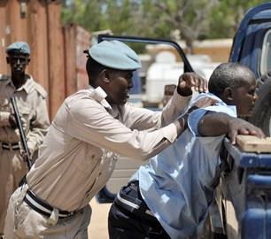
Definition of Force in Law Enforcement
Any verbal command or physical action
to gain subject control
Amount of effort required by police to compel compliance by an unwilling subject

Slide 10
Scenario 2
Two CNP officers return from a meeting with a local non-governmental organization (NGO). As they return to their station, they encounter a young man and a woman in a side street. The man is threatening the woman with a knife, shouting at her to give him the money that she just earned when selling vegetables on the market. The officers decide to intervene.
Question 1
Are the officers allowed to use force during their intervention?
Question 2
What could be the legal basis for such an intervention?

Slide 11
Scenario 2
Imagine that the officers were not from the CNP, but IPOs from UNAC.
Question 3
How should they act?
Question 4
Would it be legal for them to use non-lethal force in their actions?

Slide 12

Legal Basis for UNPOL Use of Force
Authority (when)
Security Council mandate
Status of Forces Agreement (SOFA)
Host-State law
Elaborated by mission-specific CONOPS & DUF
Limits (how)
International human rights
International criminal justice standards (especially UN Basic Principles on Use of Force and Firearms)
Further elaborated in UNPOL SGF & mission's DUF

Slide 13
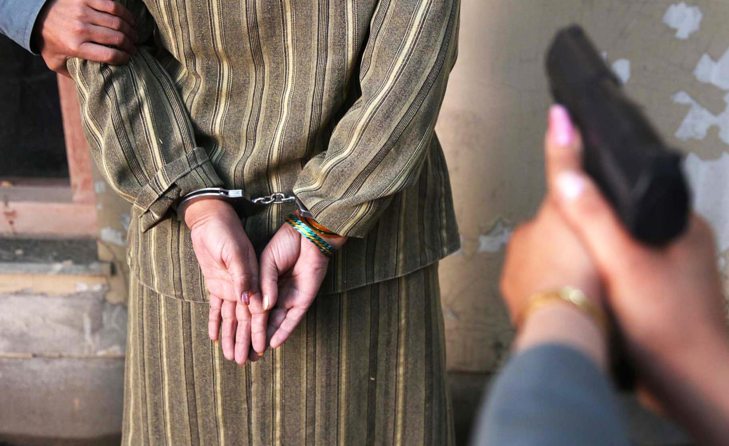
Principles:
Use of Force in Law Enforcement
  Legality
  Necessity
  Proportionality
  Non-discrimination
  Precaution (Organisation)
  Accountability
OHCHR, UNODC Resource Book on the Use of Force and Firearms in Law Enforcement (2017)

Slide 14
Legality
Defined & published
national law
(host-State police perspective)
Mandate, SOFA, CONOPS, DUF
and applicable host-State law
(UNPOL perspective)
Requirements & purpose in line with International Law:
Force to be used only for lawful enforcement purposes
No exceptions or excuses for unlawful use of force

Slide 15
Scenario 3.a
After stopping a cab in a highly populated neighbourhood in Akkabar, CNP police officers discover that the driver appears to be very nervous. He has red eyes and slurred speech. The officers ask him to get out of the vehicle and he refuses. One officer opens the driver’s door, pulls him out of the car and slams him across the hood. The other officer witnesses the situation. Unsure what to do, he decides to cuff the driver in order to make sure that he will not resist further actions taken by his colleague.
Question 1
Are the officers’ actions legal?

Slide 16
Necessity
Law enforcement must proactively deescalate potentially violent situations
Ask yourself:
1. Was it the last resort?
2. Was it minimum level?

Slide 17
Scenario 3.b
Imagine that the cab driver refuses to get out of the car. Instead, he locks the doors and pulls a short wooden club from the compartment between the front seats. While gesturing wildly, he lowers the window, throws out the car key but still refuses to get out of the car. Both officers raise their rifles while shouting at the man to drop the club. One officer decides to take action and shoots at the car, deflating a tire.
Question 2
Are the officers’ actions legal?

Slide 18

Proportionality
Act in proportion to the offence and the legitimate objective to be achieved
Respect and preserve human life, including of target persons
Use of firearms only in extreme circumstances
Strictly avoid injury or killing of innocent bystanders

Slide 19
A Range of Means for a Differentiated Response
Situation | Threat level | Typical approach (if necessary)
Regular, neutral, or passive situation, such as during lawful and peaceful assemblies | Normal | Presence, dialogue, information, and de-escalation
Non-compliant, resistant or evasive situation that presents a non-deadly threat, such as during unlawful but non-violent assemblies | Serious | Show of force and, where all other means of peaceful de-escalation have failed, use of force in a reasonable and proportional manner, using only less-lethal means and weapons
Situation has escalated to present an imminent deadly threat or serious bodily harm to police officers or bystanders | Imminent | Application of proportional and reasonable use of firearms, with intentional lethal force only where absolutely necessary to protect life

Slide 20
Means of Force
Must be proportional to the situation
Non-Violent
Presence of authority
Verbal
“Show of force”
Use of Force
Physical human force
Handcuffs and other restraints
Baton/Gas/Water
Dogs and other animals
Electroshock weapons
Kinetic impact weapons
Lethal firearms

Slide 21

Non-discrimination
IPOs and FPUs must respect and protect the human rights of every person, without discrimination on the basis of their race, colour, sex, language, religion, political or other opinion, national or social origin, property, birth or other status.

Slide 22
Precaution (Organisational Duties)
Proper planning
  Good planning and organisation ensures that police officers are not in situations where they must use unnecessary or disproportional force
Proper command and control during operations
Adequate equipment
Capable, trained personnel
Full consideration of vulnerable groups
Ensuring precaution is a command responsibility

Slide 23
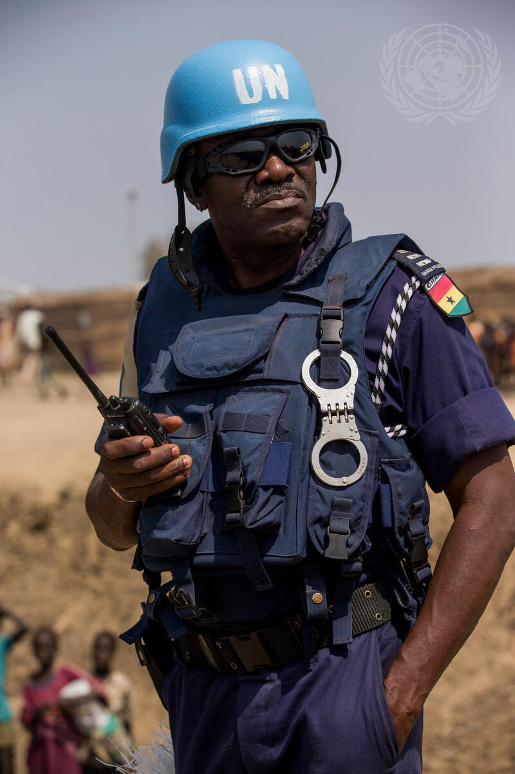
Use of Force Equipment
UNPOL must have adequate protective equipment
Authorized equipment detailed in DUF
Safety and security of UN Police is a priority
Police must be protected to protect civilians

Slide 24
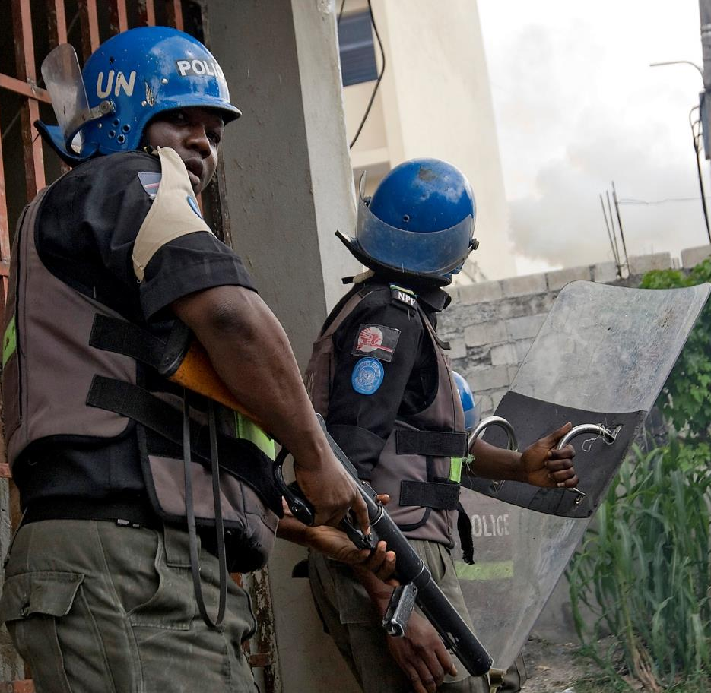
Accountability
Any incident involving use of firearms, injury or death must be reported to supervisor
Any incident involving serious injury, death or use of firearms requires sufficiently independent, impartial, prompt and effective investigation
Arbitrary or abusive use of force and firearms must be punished as a criminal offence under the law
Commanders can be responsibile for abuses of subordinates if they failed to take appropriate action to prevent or respond

Slide 25
United Nations Principles on the Use of Firearms
Firearms shall be used only in extreme circumstances:
  Self-defence or defence of others against imminent threat of death or serious injury
  To prevent serious crime that involves a grave threat of life
  Arrest or prevent escape of person posing a grave threat to life
  Intentional lethal force ("shooting to kill") only to protect life against imminent threat
  No use of firearms for the sole purpose of protecting property

Slide 26
Use of Firearms Procedure for UNPOL
Identify self as UNPOL
Give a clear verbal warning
(not warning shot)
Allow adequate
time for warning
to be obeyed

Slide 27
Scenario 4
Two IPOs from the UNAC mission are involved in a car accident. The driver of the other car is highly upset about the accident. He gets out of the car and pulls a knife while screaming and demanding the IPOs give him money for the damage to his car and for injuries that he has sustained. Fearing that the man will stab them, one IPO pulls out his sidearm and shoots the man in his leg, incapacitating him.
Question 1
Did the IPO act in line with UNPOL firearms procedures? If not, what would have been the proper course of action?

Slide 28
Scenario 4
The driver who was shot sustained a serious wound to his leg.
Question 2
What are the next steps to be taken by the IPOs?

Slide 29
Procedure After Use of Force (Especially Firearms Use)
Provide
medical aid
to all injured
persons
Notify relatives or friends of
those affected
Provide full and detailed report of the incident
Promptly initiate investigation

Slide 30
UN Police Responsibilities
Host-State Police Use Excessive Force
If UNPOL witnesses, discovers, or in any other way is made aware of host-State police’s excessive use of force or another human rights violation, UNPOL shall:
Put an end to the violation and/or prevent further violations in line with the mandate and capacity;
Provide assistance to the victim(s) as necessary;
Mentor and advise host authorities accordingly;
Record relevant information and violation for immediate supervisor;
Report the violation to human rights component of the mission and consult on further necessary action; and
Keep information on victims & witnesses confidential.

Slide 31
UN Police Responsibilities
Own Exercise of Force
Exceptionally, UNPOL may use force under a non-executive mandate:
In self-defence or defence of others;
In defence of the mandate (e.g., when asserting freedom of movement);
If mandated to protect civilians from violence.
Any use of force by UNPOL must be carried out in accordance with the applicable host-State law and/or any UN regulations that may have replaced it and with full respect
for International Human Rights and Criminal Justice Standards.

Slide 32
Discussion: Impact of Use of Force
Appropriate Use of Force
What’s the impact?
Inappropriate Use of Force

Slide 33
Take Away
WHAT?
SO WHAT?
NOW WHAT?
What did you notice?
Which elements stood out?
Make sense of the facts.
How do they affect your work as an IPO?
Why is this important?
What actions will you take in the mission?

Slide 34
Questions?

