Slide 1
Human Rights Due Diligence Policy

Slide 2
Aim
To familiarise UNPOL with the responsibilities and opportunities emerging from the United Nations Human Rights Due Diligence Policy (UN HRDDP) on UN support to non-UN security forces

Slide 3
Relevance
The UN HRDDP is a binding policy, established by the Secretary-General and repeatedly endorsed by the UN Security Council
Risk management: the UN needs to safeguard its reputation and must not become morally or legally complicit to grave human rights violations
Human rights promotion: the UN uses its security support as a lever to achieve positive change

Slide 4
Learning Objectives
Illustrate the due diligence responsibilities for UNPOL when providing support
List the main elements of HRDDP risk assessments
Describe possible mitigation measures to prevent human rights violations associated with joint operations or operational support
Explain the leverage the HRDDP can provide in advancing the UN Police agenda

Slide 5
Lesson Overview
Basic Principles of the HRDDP
Scope of Application
Risk Assessment
Mitigation Measures
Monitoring Compliance and Intervention
Mission Modalities to Implement the HRDDP

Slide 6
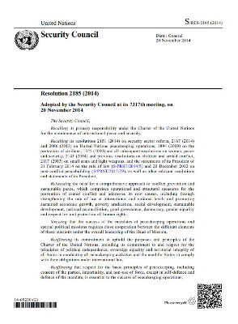
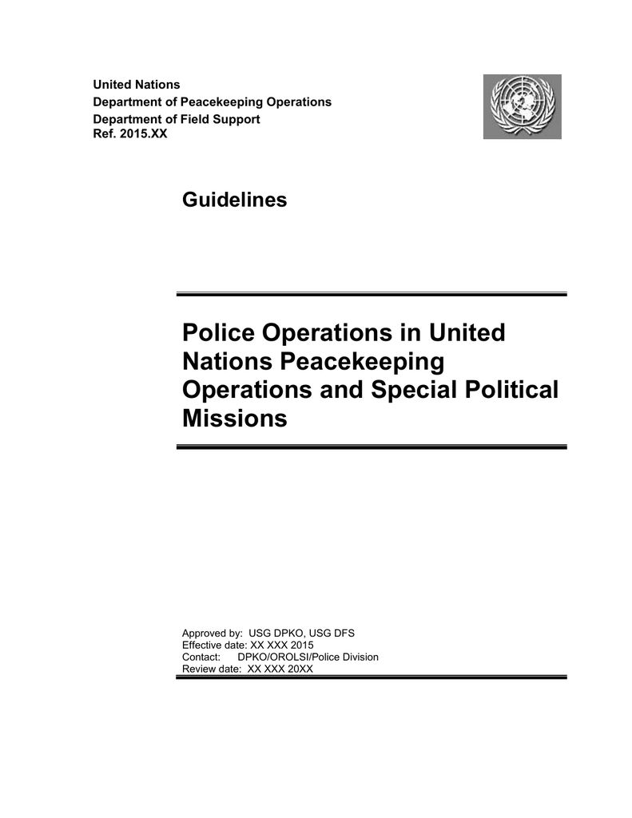
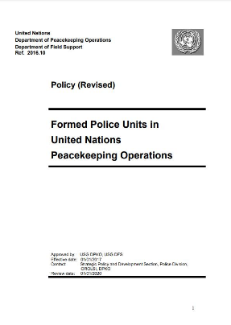
HRDDP in the Strategic Guidance Framework

Slide 7
HRDDP in UN Support to Non-UN Security Forces
The United Nations cannot provide non-UN security if:
  There is a real risk of the receiving entities committing grave violations of international humanitarian, human rights or refugee law
  Relevant authorities fail to take the necessary corrective or mitigating measures
Prevents legal liability for aiding violations and protects UN credibility and impartiality

Slide 8

Who are Non-UN Forces?
Policy excludes:
UN peacekeeping forces, private security companies or non-State armed groups
National military, paramilitary, police, Intelligence services, border control … and similar security forces
National civilian, paramilitary or military authorities in charge of such forces
(e.g., Ministry of Interior)
Peacekeeping forces of regional international organisations (e.g., AU police components)

Slide 9
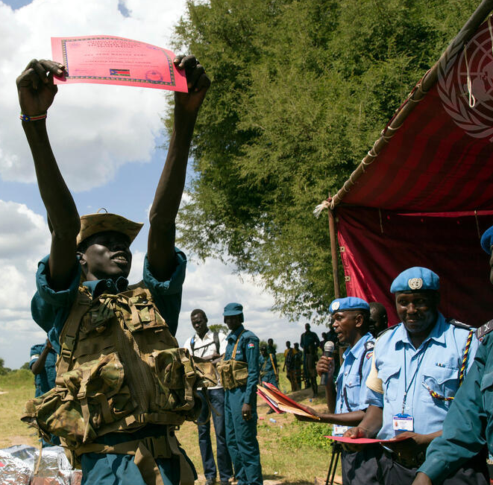
What is UN Support?
Within scope:
  Joint operations
  Training, mentoring, and technical cooperation
  Operational and logistical support
  Sharing of intelligence
  Financial support
Excluded:
  Mediation
  Medevac
  Human rights-related activities
HRDDP applies regardless whether ad hoc or programmatic support

Slide 10
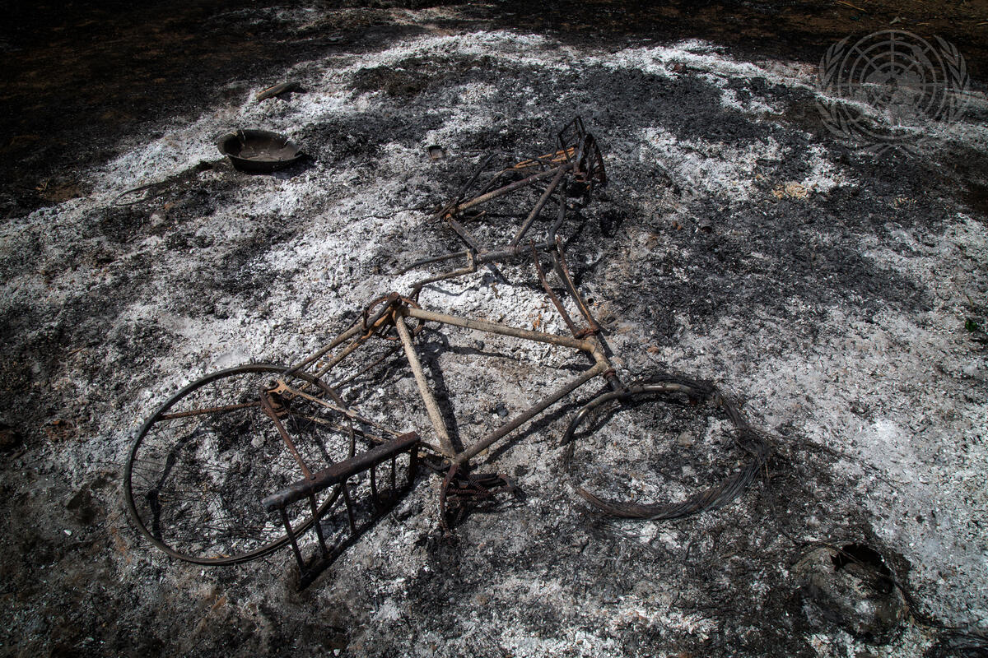
Grave Violations Under the HRDDP
War crimes
Crimes against humanity
Gross human rights violations (summary executions, torture, inhumane treatment, sexual violence, enslavement etc.)
Patterns of repeated violations of IHL, HR or refugee law

Slide 11
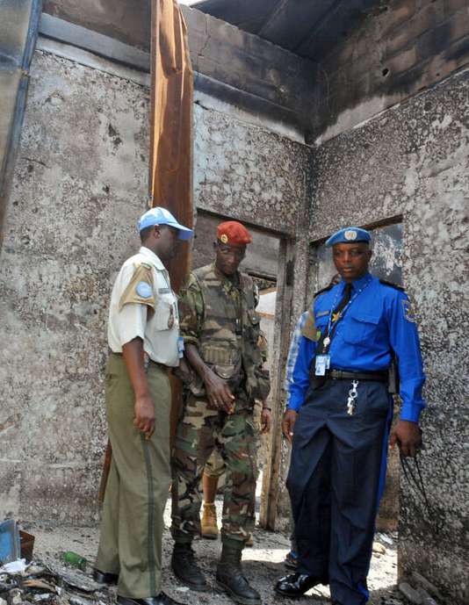
HRDDP Implementation
Communication to host-State (by SRSG)
Risk assessment (initiated by UNPOL)
and adoption of mitigation measures
Monitoring of situation (by UNPOL, involving others such as HR component)
Intervention, as necessary
Support suspension or withdrawal as last resort

Slide 12
HRDDP Risk Assessment:
Factors to Consider
Human rights record of recipient (e.g., past use of excessive force)
Accountability record (disciplinary/criminal sanctions)
Prevention mechanisms (e.g., oversight mechanism)
Legislative / policy framework for operations
Feasibility of monitoring framework by UN or others
Risks inherent to particular operation and kind of support
UN ability to influence and risks of not providing support

Slide 13
Learning Activity 4.1: Risk Assessment
Instructions
Carefully read the case study
In your groups:
  Identify the risk factors for giving UNPOL support to the Leopard Special Police Unit
  Record your answers on chart paper
Present your ideas to the plenary
  Time: 20 minutes
  Groups:10 minutes
  Discussion: 10 minutes

Slide 14

Mitigation Measures in Risk Assessment
Medium or high risk
Risk Assessment
Mitigation measures
Acceptable risk

Slide 15
Learning Activity 4.2: Mitigation Measures
Instructions
A host-State requests UNPOL and its FPUs to support national police on crowd control in relation to major opposition demonstrations. However, the national police often uses excessive force in handling such demonstrations.
Discuss in your groups:
  What mitigating measures would you recommend to reduce the risk that supported national police units engage in excessive force?
  How can mitigating measures provide strategic leverage to advance UNPOL’s objectives?
Record your answers on a chart paper
Present your ideas to the plenary
  Time: 20 minutes
  Groups:10 minutes
  Discussion: 10 minutes

Slide 16
Debrief: Mitigation Measures for Crowd Control Support
Joint planning of operations
Exclusion of problematic national units from supported operations
Providing non-lethal weapons and training on their use
Reviewing/revising orders for compliance with international standards
Joint monitoring by UNPOL and Human Rights Officers (HROs) of crowd control
UN access to detainees who were arrested in operation
HRDDP is risk management, not blunt conditionality

Slide 17
Debrief : Mitigation Measures for Crowd Control Support
Human rights training for police
Commitments to ensure accountability for identified past cases of excessive force
Police reforms to ensure command and control of operations and strengthen independent oversight mechanisms
Vetting of national riot police to remove problematic officers
Lessons learned meetings between national police and UNPOL
HRDDP is risk management, not blunt conditionality

Slide 18
Lessons Learned from UN Military:
To mitigate risks of joint military operations:
  Conduct joint planning and contingency planning
  Perform after action reviews
  Use background checks
  Exclude problematic units and commanders
  Insist on individual accountability and case referral

Slide 19
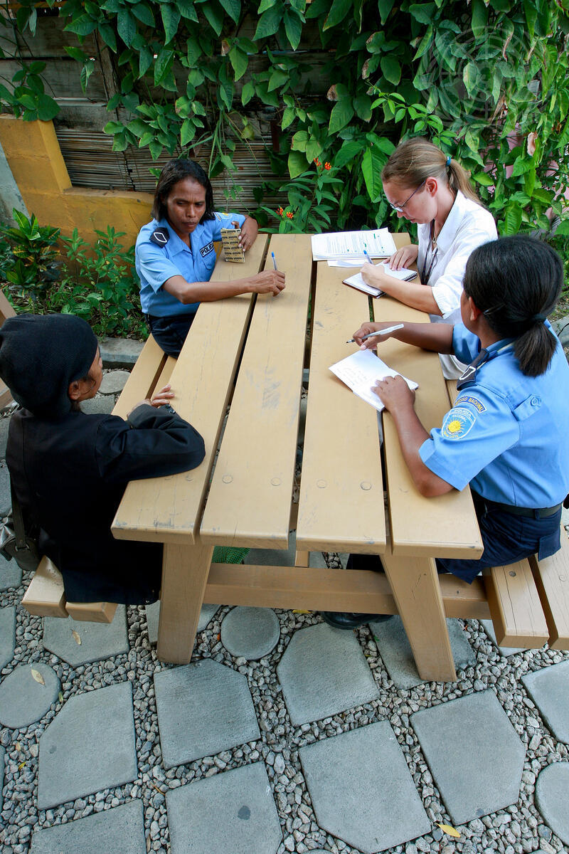
Monitoring and Intervention
Monitoring System:
Responsibility
of supporting entity
Cooperation with HR component
Intervention:
Mitigation
and dialogue
Suspension/
Withdrawal
of support

Slide 20
HRDDP Implementation
How
  Implementation framework
  (Mission-specific SoP on HRDDP)
Who
  HRDDP Taskforce operating at senior and working level
When
  Before support is given and throughout duration of support

Slide 21
Take Away
WHAT?
SO WHAT?
NOW WHAT?
What did you notice?
Which elements stood out?
Make sense of the facts.
How do they affect your work as an IPO?
Why is this important?
What actions will you take in the mission?

Slide 22
Questions

