Slide 1

Community-oriented Policing

Slide 2
Aim
To provide United Nations Police with an understanding of the scope and basic concepts of Community-oriented Policing (CoP) philosophy within the peacekeeping and peacebuilding context.

Slide 3
Relevance
The Community-oriented Policing approach shall guide all operational activities of the United Nations police to support the host-State for restoring and nurturing the consent of the public in their own police.

Slide 4
Learning Objectives
Explain the concept of CoP
Describe the benefits of CoP
Explain the four essential elements of CoP
Illustrate the problem-solving process
Identify the challenges in CoP implementation

Slide 5
Lesson Overview
What is Community-oriented Policing?
Main Guiding Documents
The Benefits of CoP
Four Essential Elements of CoP
Problem Solving
Implementing CoP
Constraints, Risks and Challenges

Slide 6
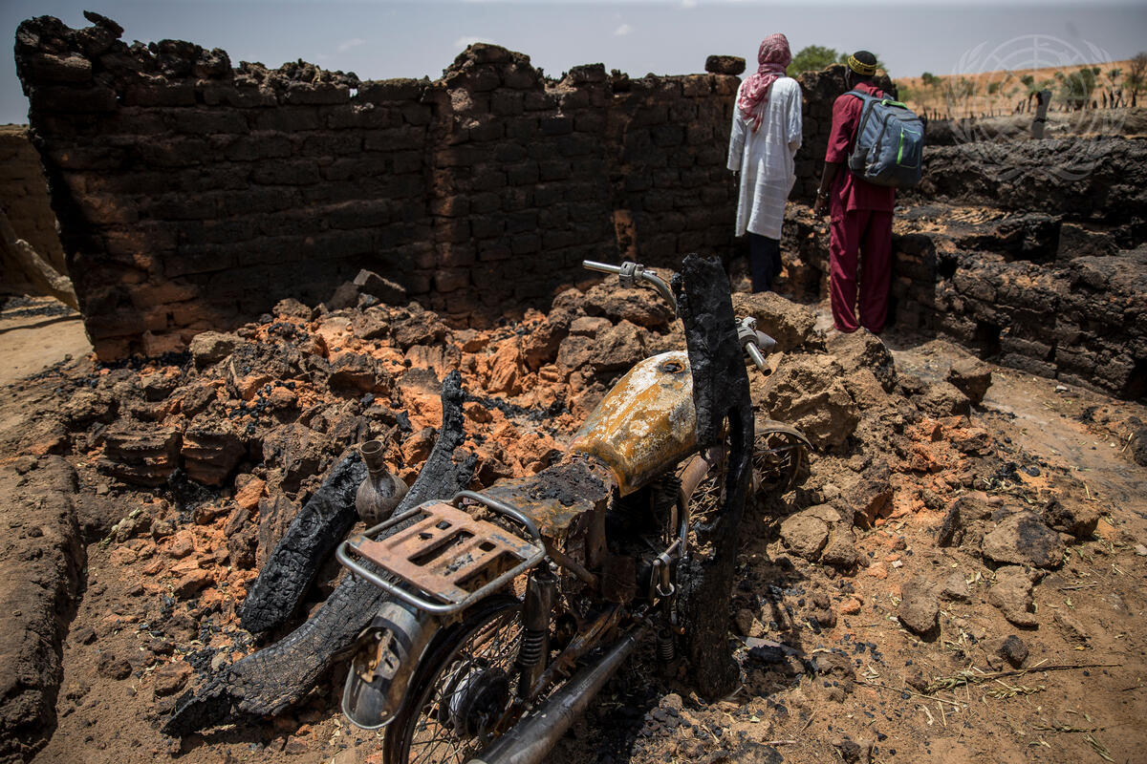
Post-conflict Environments
Widespread human rights violations
Weak police legitimacy
Weak protection for civilians
Absence of State authorities
Increasing criminality
Breakdown of the rule of law
Violent extremism, and terrorism

Slide 7


What is Community-oriented Policing?
Philosophy
Organizational Strategy
CoP
A strategy for encouraging the public to act as partners with the police in preventing and managing crime as well as other aspects of security and order based on the needs of the community.
Reference: DPKO/DFS Manual “Community-oriented Policing in Peace Operations”

Slide 8
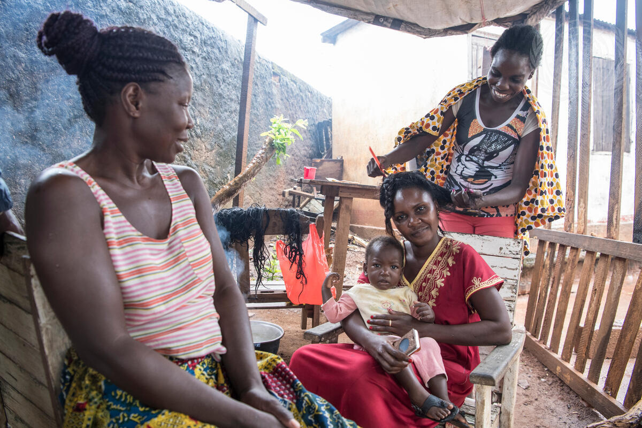
Definition of Community
A group of people, often living in the same place, who share a common culture, religion, ethnicity, values, norms and concerns

Slide 9
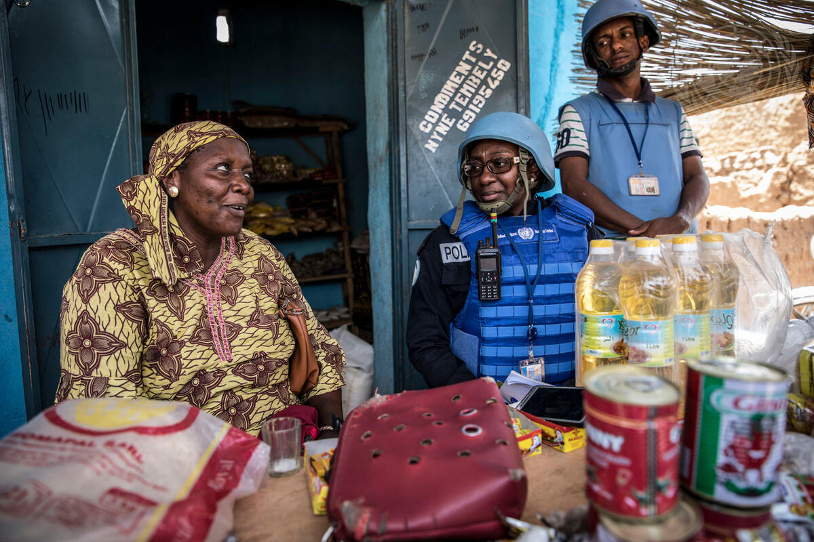
How Does Community-oriented Policing Work?
Community participating in its own policing and supporting the police
Police participating in the community and responding to the needs of the community

Slide 10
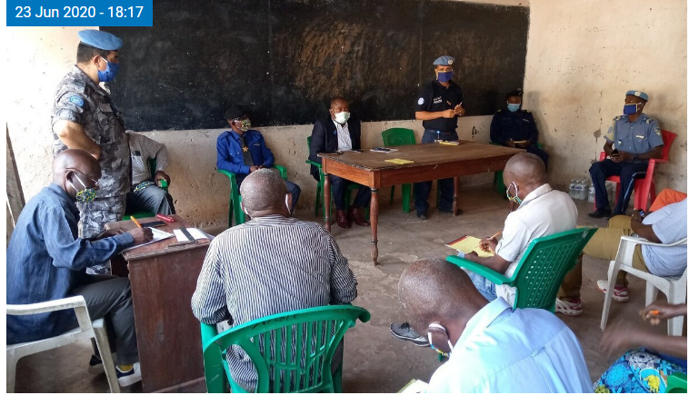
CoP Example: Building Trust
Goal: Build and strengthen trust between district leaders and the Congolese National Police (PNC) in the protection of civilians
Initiative: MONUSCO facilitated a meeting between district leaders and PNC senior officers in Kalemie, Tanganyika province

Slide 11
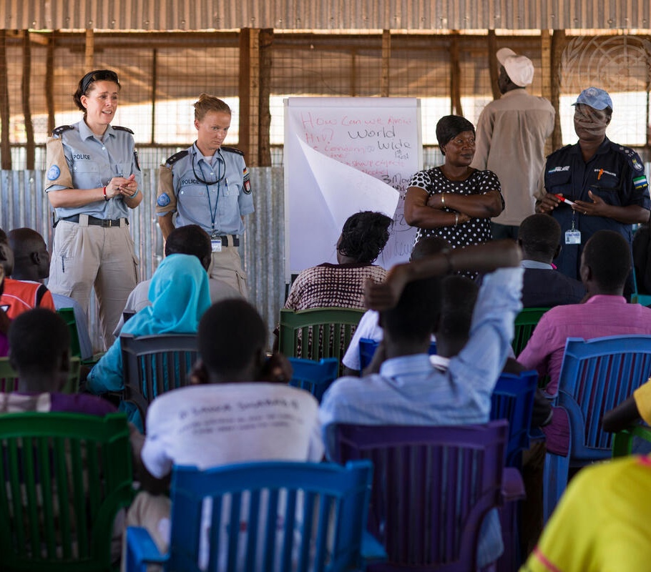
Community-oriented Policing Approach
Community problems require community solutions and support
Gender issues are to be mainstreamed within all CoP activities
Respect for and protection of human rights

Slide 12
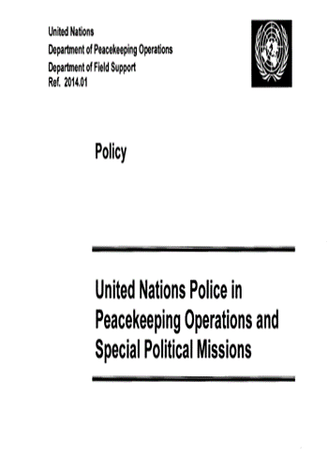
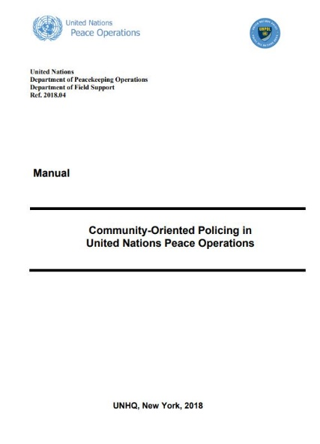
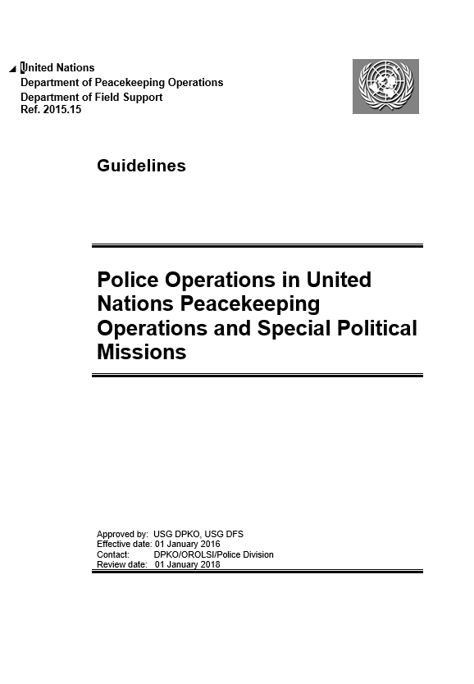
Main Guiding Documents

Slide 13
Learning Activity 5.1
Instructions
Discuss in your groups: Why is it important to enlist the community in crime prevention and control?
  Time: 15 minutes
  Discussion: 5 minutes
  Presenting: 10 minutes

Slide 14
Benefits of CoP
Community trust
Crime prevention
Information about crimes
Advance warning
Prevention of radicalisation
Community resilience
Information sharing
Gaining support for policing
Prevention or mitigation of inter-communal conflict
Mutual Respect
Community expectations and public information

Slide 15
Learning Activity 5.2
Instructions
Discuss in your groups: Compare traditional policing with Community-oriented Policing
  Time: 20 minutes
  Discussion: 10 minutes
  Presenting: 10 minutes

Slide 16
Four Elements:
Community-oriented Policing
Consultation with Communities
Responding to Communities
Solving Recurring Problems
Mobilizing Communities

Slide 17
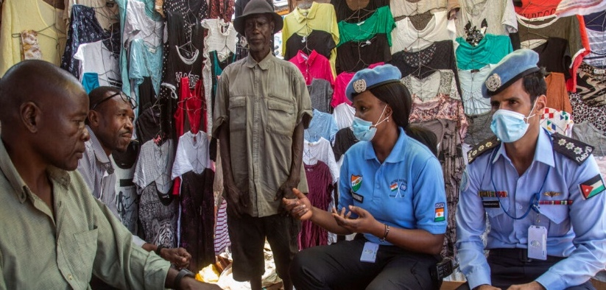
Consultation with Communities
What?
Who?
How?

Slide 18
Consultation with Communities
Topics:
  crime
  disorder
  activities that generate fear
What?

Slide 19
Consultation with Communities
Main stakeholders:
  local councils
  government departments
  the community
Who?

Slide 20
Consultation with Communities
Main grassroots groups:
  Residents’ associations
  Economic interests, such as banks, shopkeepers, taxi drivers, and apartment owners
  Public service providers or organizations, such as hospitals, shelters for battered women, etc.
  Leaders of social/ethnic groups, such as tribes in Africa, and immigrants everywhere
Who?

Slide 21
Consultation with Communities
Main grassroots groups:
  Women’s organizations and leaders
  Village and community elders
  Religious leaders
  Vulnerable groups – visible minorities, IDPs, women and children, LGBT, elderly, etc.
  Marginalised groups – drug users, migrants
  Other possible post-conflict formations
Who?

Slide 22
Consultation with Communities
Tools:
  Provision of information
  collaboration
  coordination
  partnership
How?

Slide 23
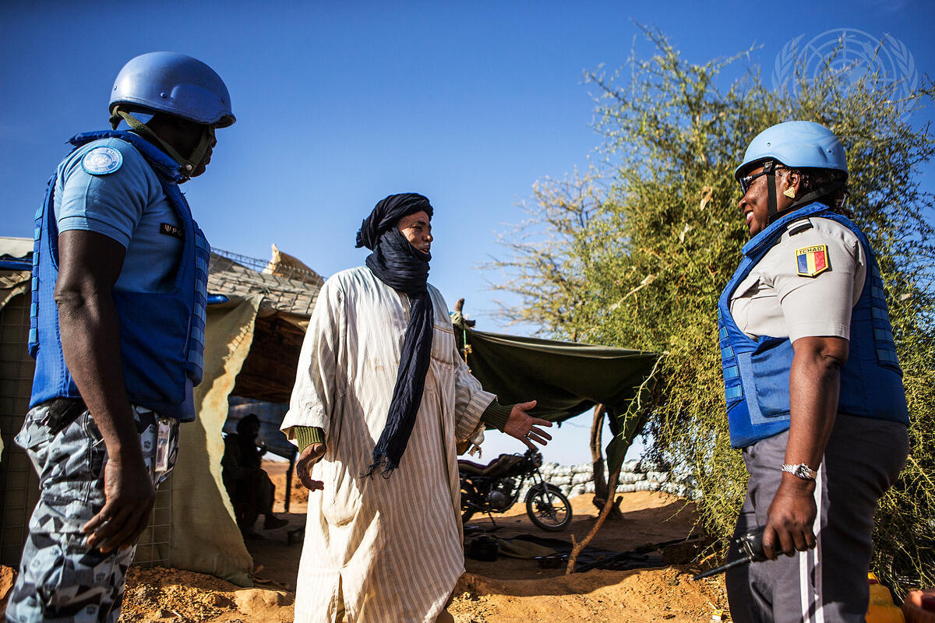
Responding to Communities
Police treat the public as clients to be served
Pro-activeness
Visibility
Accessibility
Timeliness
Effectiveness

Slide 24
Mobilizing Communities
Crime prevention advice
Training local police, local leaders etc. to solve problems at the local level
Activate community participation; e.g., neighbourhood watch
The police must always retain the authority and control for policing

Slide 25
Learning Activity 5.3
Instructions
Discuss in your groups: What activities and programs can police use for mobilizing communities in their own defense?
  Time: 15 minutes
  Discussion: 5 minutes
  Presenting: 10 minutes

Slide 26
Definition of Problem in the CoP Context
  A recurring set of related harmful events in a community
  Events that members of the public expect the police service to address
  Events such as domestic violence which tend to be ignored/accepted by some communities

Slide 27
Chronic Problems in Mission Settings
Chronic problems that account for repeated police attention and have been subject to problem solving include:
Violent crimes on political, ethnic, religious, etc. grounds
Revenge crimes
Sexual
crimes
Looting
Thefts, robberies
Illegal possession of arms, etc.

Slide 28

Problem-Solving Process: SARA
Scanning
Analysis
Response
Assessment

Slide 29
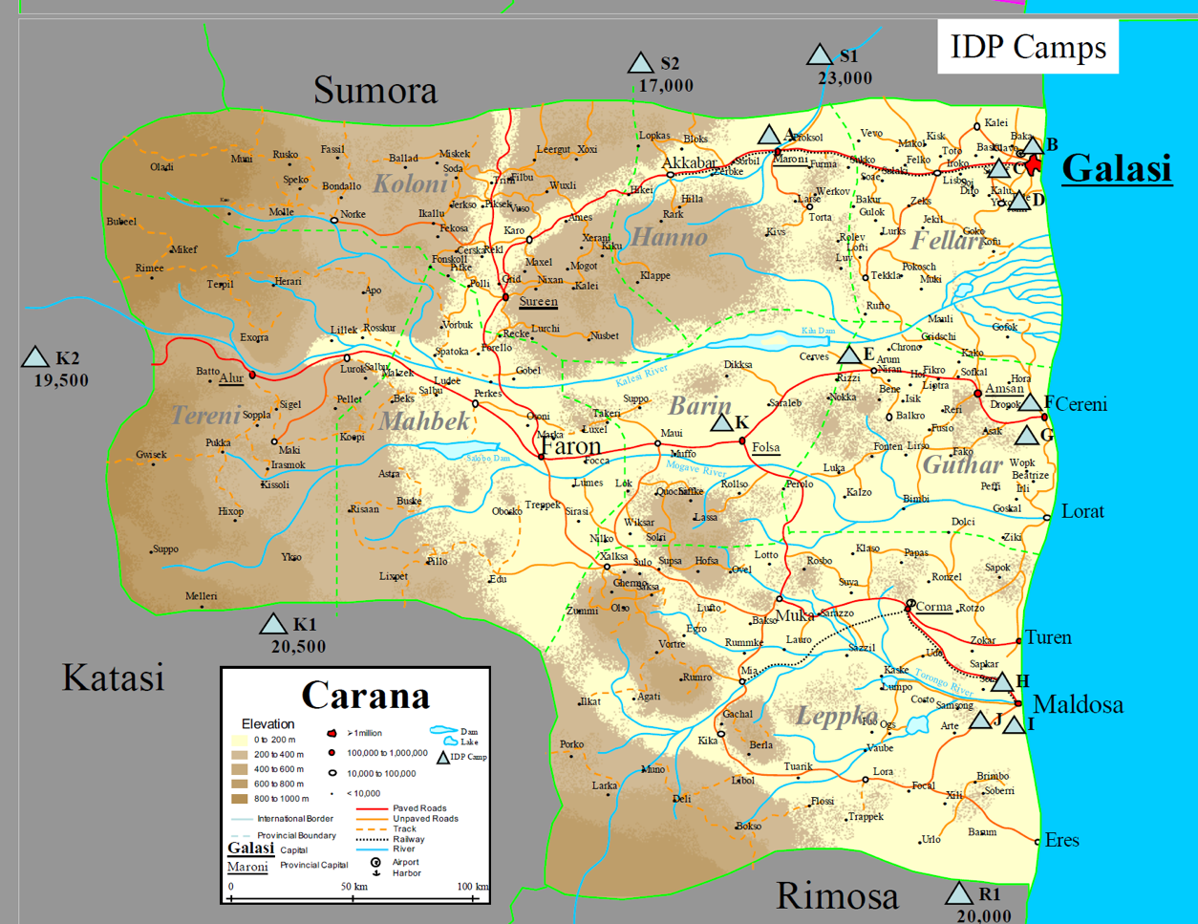
SARA’s Application
In the IDP camp in Galasi, Carana, UNPOL reported increasing cases of vagrant children and arrested women.

Slide 30

SARA’s Application
Scanning
Problems identified: Women in the camps were brewing beer to provide a source of income. This was illegal and women were arrested which led to other problems such as unattended children. This caused problems with vagrant children.
Analysis
These women had limited skills to provide other ways of income within the IDP camp.
Response
Based on abilities and resources in the camp, Women trained in dyeing skills to make and sell clothing.

Slide 31
SARA’s Application: Assessment
The cases of women being prosecuted brewing local beer have been reduced.
The numbers of unattended children who caused problems due to vagrancy and boredom have also been reduced, and children were able to go to school.
The relationship between the host-State police and the IDP community has significantly improved.

Slide 32
Goals of CoP Implementation
Community resilience
Support for law enforcement
Advance warning
Calm a disenfranchised society and contribute to the restoration of peace
Mutual respect

Slide 33
Basic Requirements to Implement CoP
Minimum degree of law and order in the country
Commitment to implement CoP
Basic management skills within the police
Opportunities for civil society engagement
Adequate resources & donor support and coordination

Slide 34

CoP Planning Process
Local assessment: Methodology and exploratory study
Local assessment: Collection
and analysis of information
Local assessment: Production of the assessment report
Local assessment: Restitution
and validation of the report
Draft of the action plan
Resources mobilization

Slide 35
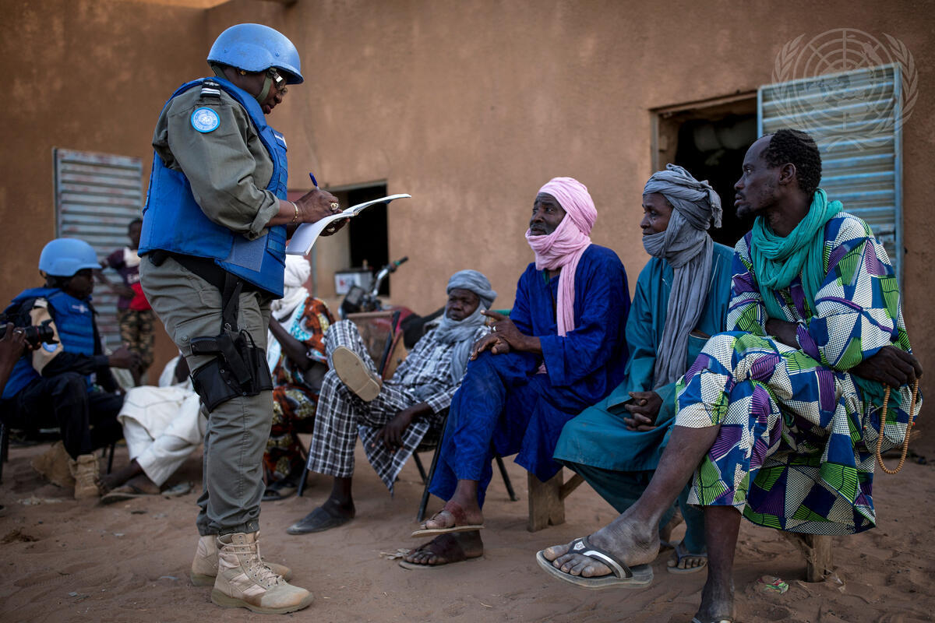
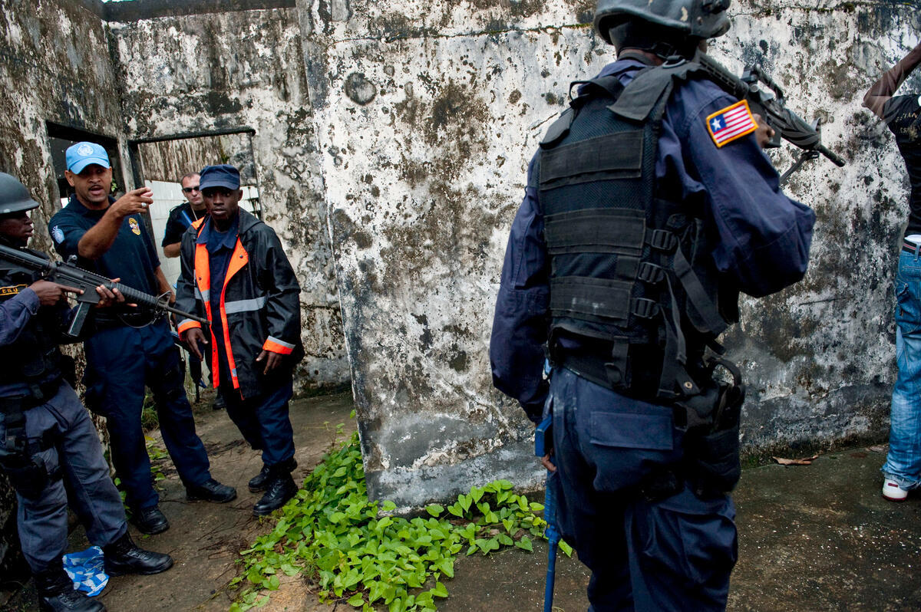
Initial Step: Local Assessments
Nature & Conditions of Local Communities
Capacity & Capabilities of the Local Police

Slide 36
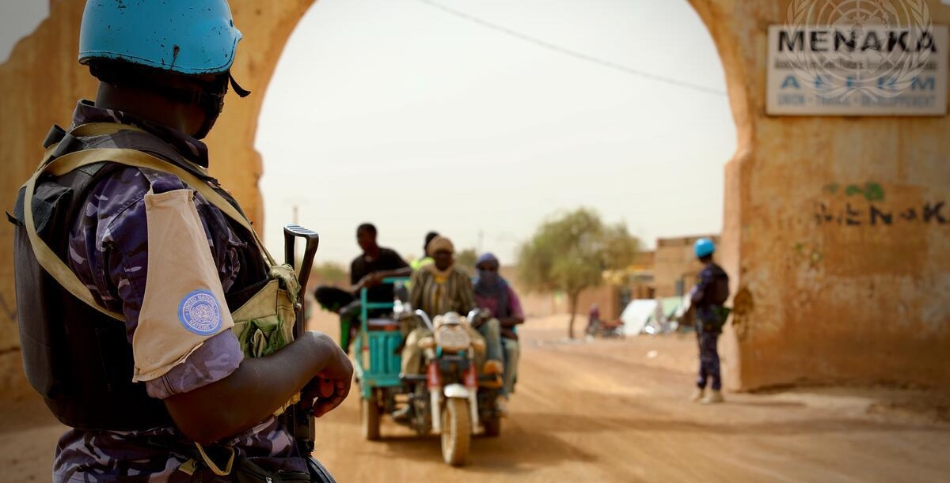
Constraints, Risks and Challenges
Local authorities
Local community
Local police
International environment
UN Police

Slide 37
Take Away
WHAT?
SO WHAT?
NOW WHAT?
What did you notice?
Which elements stood out?
Make sense of the facts.
How do they affect your work as an IPO?
Why is this important?
What actions will you take in the mission?

Slide 38
Questions

