Slide 1
Intelligence-led Policing

Slide 2
Aim
To provide participants with a general understanding of the scope and basic concepts of Intelligence-led Policing (ILP) in Peace Operations and the implications for their daily work as IPOs.

Slide 3
Relevance
The overarching approaches of Community-oriented Policing (CoP) and Intelligence-led Policing(ILP) shall guide all operational activities of the United Nations Police to support the host-State for restoring and nurturing the consent of the public in their own police.
2

Slide 4
Learning Objectives
Learners will be able to:
Explain the concept and benefits of ILP in the context of UN Peace Operations
Illustrate the link between information/intelligence/intelligence cycle
Describe daily ILP activities in Peace Operations
Illustrate the implications of ILP for Capacity-building and Development
Identify basic guidelines for writing UN reports
3

Slide 5
Lesson Overview
Background and definitions
Purpose and concept within the Strategic Guidance Framework (SGF)
Information/Intelligence/Intelligence Cycle
ILP-related daily activities
Reporting
4

Slide 6
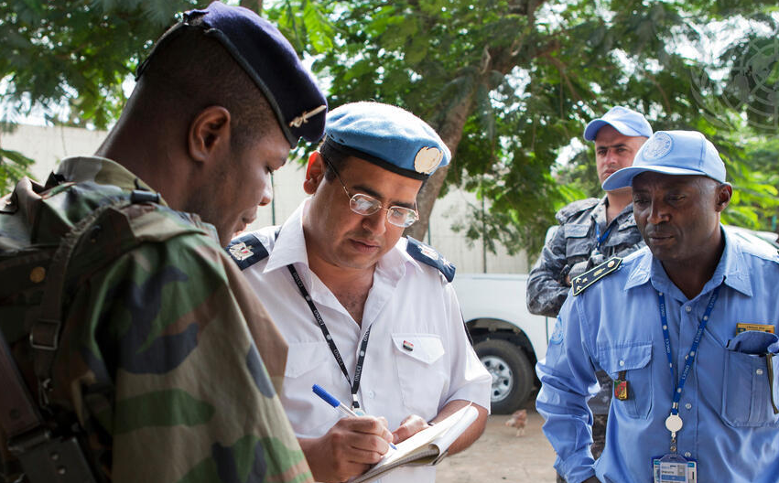
Discuss: Role of Information
What role does information play in your domestic context?

Slide 7

Converting Information to Intelligence
Information
Analysis/
Evaluation
Intelligence
Knowledge in raw form
  The process of adding meaning and relevance
  Assessing reliability
  Information that is capable of being understood
  Information that has been evaluated in context to its source and reliability

Slide 8

Definition:
Crime Intelligence
Criminal Intelligence
  Processed Information on criminals
Crime Analysis
  Processed information on crimes
  Qualitative and quantitative study of crime
Crime Intelligence

Slide 9
Definition:
Intelligence-led Policing
The use of processed information as the fundamental basis for an objective, decision-making framework
to facilitate crime and problem prevention, reduction, disruption and dismantling
through both strategic management and effective enforcement strategies targeting serious crimes and/or prolific offenders

Slide 10
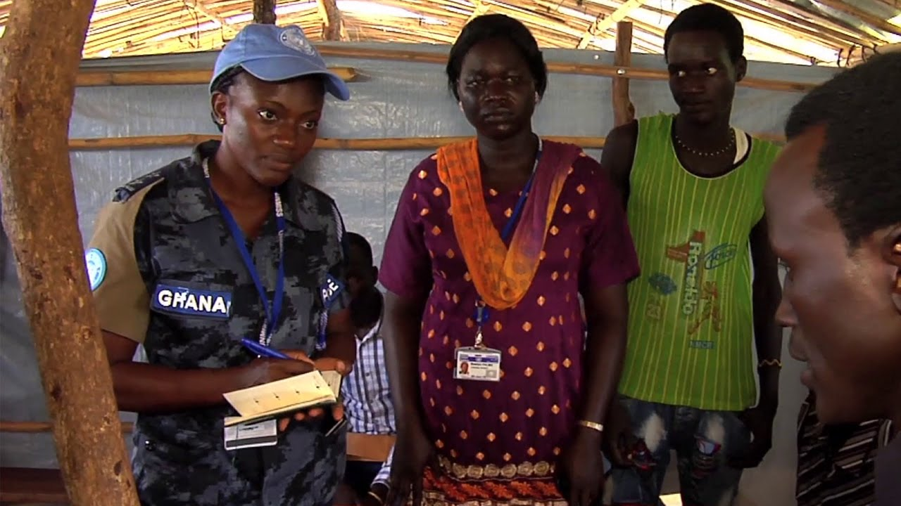
Discuss: Benefits of ILP
What are the Benefits of ILP?

Slide 11
Peacekeeping-Intelligence
Non-clandestine collection, analysis and dissemination of information by a Mission
within a secure and directed mission intelligence cycle
in compliance with the United Nations Charter and Peacekeeping principles
to enhance situational awareness and the safety and security of UN personnel
to inform operations related to the protection of civilians’ tasks of Security Council mandates

Slide 12
CoP and ILP
UN
Police
Community-oriented Policing
Intelligence-led Policing

Slide 13
Similarities
CoP and ILP
  Policing philosophy
  Proactive
  Preventive element
  Depends on strong community relationships
  Information from the public
  is highly sought
  Two-way flow of information
  Can be implemented in multiple ways
COP
ILP

Slide 14
Conceptual Differences
CoP and ILP
Focuses on objective data and analysis to more effectively reduce, disrupt and prevent crime
Helps identify priorities/latent security problems
Helps to deploy police resources more effectively and efficiently
Focus on community empowerment
Helps identify visible neighbourhood-level issues
Focuses on fear reduction
COP
ILP

Slide 15
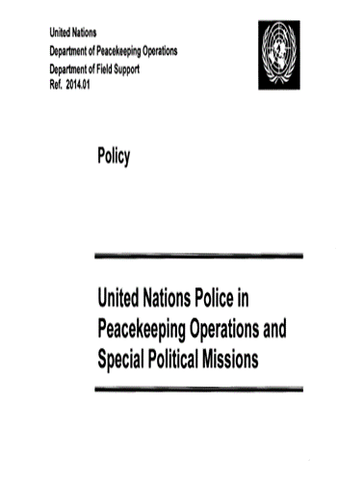
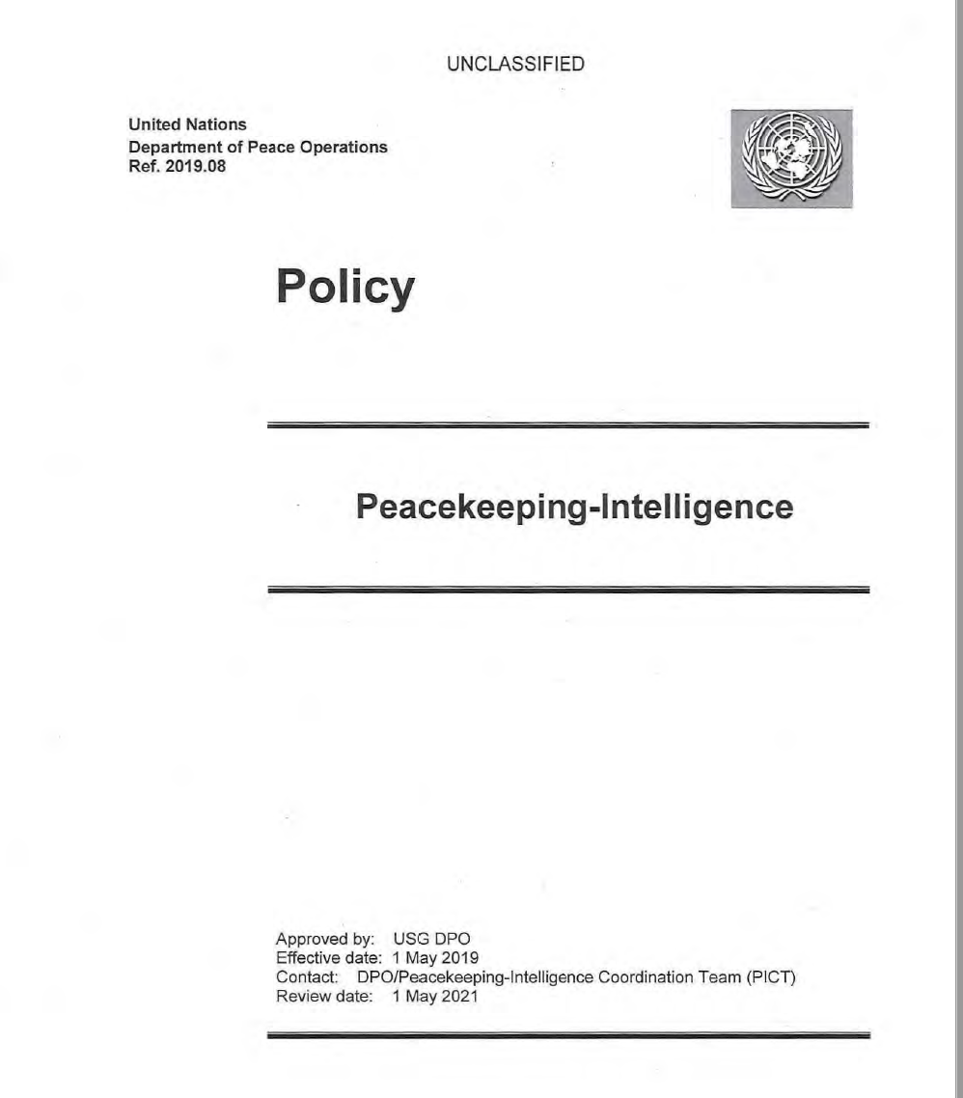
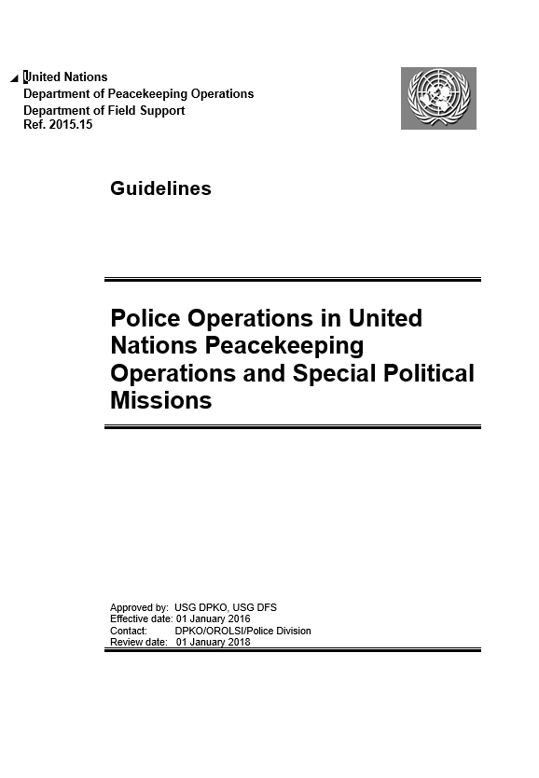
Main Guiding Documents
Manual
Intelligence-led Policing (forthcoming)

Slide 16

UNPOL Crime Intelligence Cycle
Direction
& Planning
Decision
Dissemination
Collection
Analysis
and Inference Development
Evaluation & Collation

Slide 17
Learning Activity 6.1
Instructions
Brainstorm: Building on your experience with information and intelligence, how can you use ILP in your daily activities as UNPOL?
Time: 15 minutes
Brainstorming: 5 minutes
Discussion: 10 minutes

Slide 18
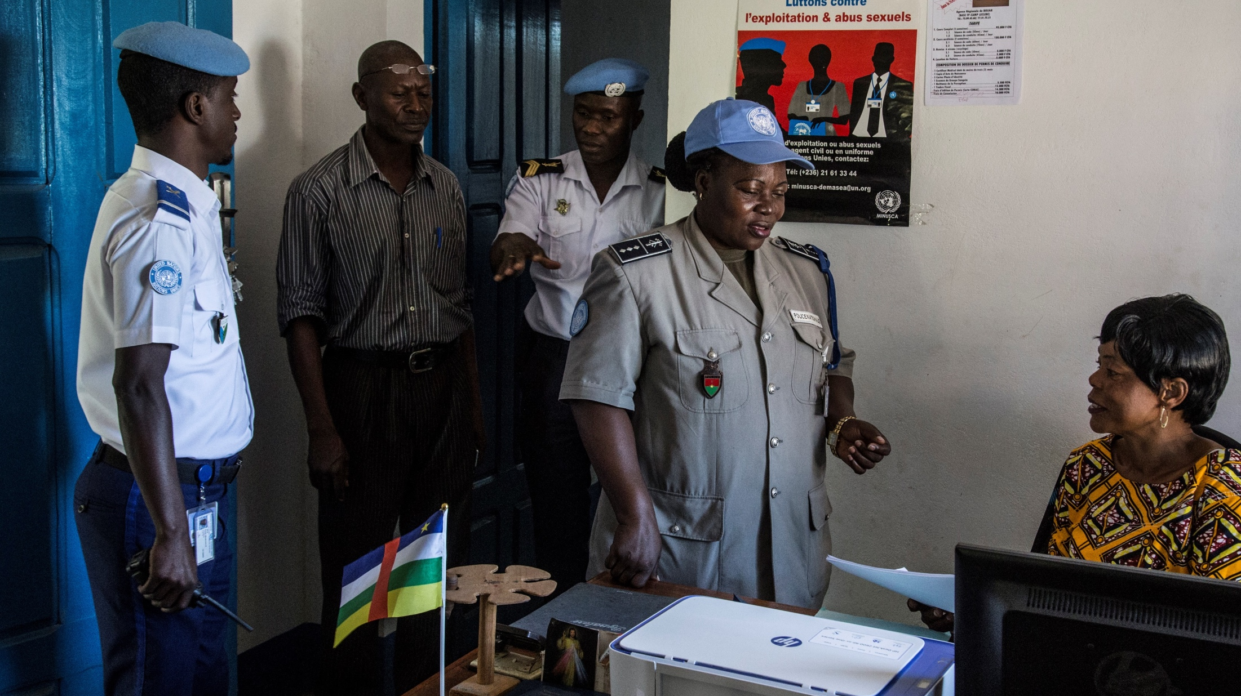
Discuss: Reporting
Why is reporting important?

Slide 19
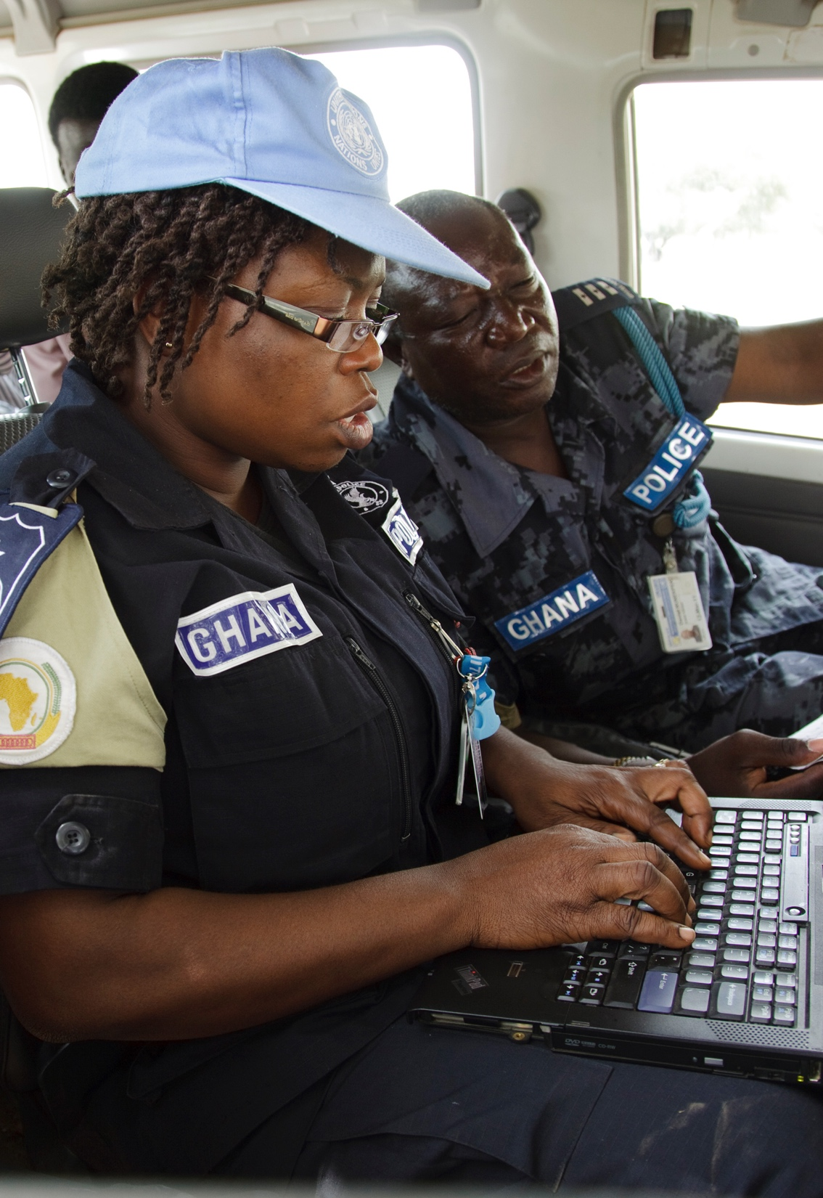
Examples of UN Reports
Patrol reports
Situational report
Daily/weekly report
Incident report
Thematic report
Flash report
... and many more

Slide 20

Basic Guidelines: Content
Personal data
Report data (5 Ws and 1 H):
  Where
  When
  What
  Who
  Why
  How

Slide 21
Basic Guidelines: Style
Writing principles
  Accurate
  Brief
  Complete
  Clear
  Objective
  Well formatted

Slide 22
Basic Guidelines: Style
Basic writing rules
  Abbreviations
  Format
  Dates and times
  Names and places
  Numbers
  Spelling

Slide 23
Take Away
WHAT?
SO WHAT?
NOW WHAT?
What did you notice?
Which elements stood out?
Make sense of the facts.
How do they affect your work as an IPO?
Why is this important?
What actions will you take in the mission?

Slide 24
Questions

