Slide 1
Monitoring, Mentoring and Advising

Slide 2
Aim
To provide participants with a clear understanding of the basic concepts and strategies of UN Police Monitoring, Mentoring and Advising (MMA) to better support law enforcement personnel and agencies in a post-conflict environment

Slide 3
Relevance
  Monitoring, Mentoring and Advising (MMA) are key methods in capacity-building and the wider police development process and are fundamental to the United Nations Police’s ability to anchor police development truly within national ownership.
  Therefore, UN Police Officers must understand how MMA contributes to successful mandate implementation, which UN guidance and policies to refer to and how to manage challenges related to MMA.

Slide 4
Lesson Overview
  Introduction to Monitoring, Mentoring and Advising
  MMA in UN Peace Operations
  Challenges Related to MMA
  MMA Reporting and Documentation

Slide 5

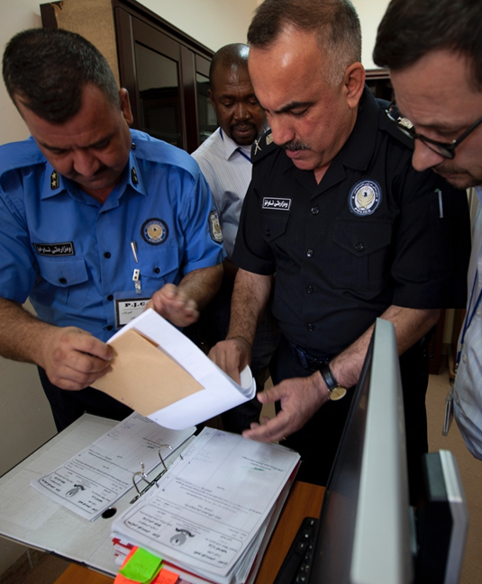
Introduction to Monitoring, Mentoring and Advising

Slide 6
Learning Objectives
Learners will be able to:
  Define Monitoring, Mentoring and Advising (MMA)
  Identify the UN guidance and policy framework of MMA in UN Peace Operations
  Explain the role of MMA in developing the capacities of national law enforcement agencies

Slide 7
Growing Complexity of Police Tasks
Protection of Civilians and others
UNFORSEEN
Transnational crime
Transnational crime
Integrated
approach
(RoL, SSR)
Integrated approach (RoL, SSR)
Integrated approach (RoL, SSR)
DEVELOPMENT
Law Enforcement Capacity Building
Law Enforcement Capacity Building
Law Enforcement Capacity Building
Law Enforcement Capacity Building
Reform, Restructuring & Rebuilding
Reform and Restructuring & Rebuilding
Reform and Restructuring & Rebuilding
Reform and Restructuring & Rebuilding
Reform Restructuring & Rebuilding
FPU
Operational Support
Operational Support
Operational Support
Operational Support
Operational Support
Advisory Support
Advisory
Support
Advisory
Support
Advisory Support
Advisory Support
Advisory Support
STABILIZATION AND IMPROVEMENT
Training and Mentoring
Training and Mentoring
Training and Mentoring
Training and Mentoring
Training and Mentoring
Training and Mentoring
Training and Mentoring
Interim Law Enforcement
Interim Law Enforcement
Interim Law Enforcement
Interim Law Enforcement
Interim Law Enforcement
Interim Law Enforcement
Interim Law Enforcement
Humanitarian Assistance
Humanitarian Assistance
Humanitarian Assistance/ Protections
Humanitarian Assistance/ Protection
Humanitarian Assistance/ Protection
Humanitarian Assistance/ Protection
Humanitarian Assistance/ Protection
Humanitarian Assistance/ Protection
Humanitarian Assistance/ Protection
EMERGENNCY RESPONSE
Monitoring
Monitoring
Monitoring
Monitoring
Monitoring
Monitoring
Monitoring
Monitoring
Monitoring
1962-1999
1999 - 2002
2002 - 2008
2008 - 2019

Slide 8
Purpose of Monitoring, Mentoring, and Advising (MMA)
Key methods in capacity-building and the wider police development process
Fundamental to UNPOL’s ability to anchor police development truly within national ownership
Advising
Monitoring
Mentoring

Slide 9

Different Contexts of Monitoring
Traditional Monitoring
  Ensuring respect for human rights
  Historically a core task for UN Police
  Observing
  Reporting
Monitoring within MMA
  Observing performance and conduct to improve performance through mentoring and advising
  Continuing to ensure respect for human rights

Slide 10
Definition of Mentoring
UNPOL ‘shadowing’ the host-State police officer with a view to witnessing the application of new knowledge and skills by the host-State officer and assisting him/her in performing tasks, promoting professional growth and, overall, enhancing the effectiveness of the host-State police service or other law enforcement agencies

Slide 11
Definition of Advising
Working together with the host-State police and other law enforcement agencies to find solutions to their problems and to improve their performance

Slide 12
Learning Activity 8.1:
Identifying MMA Mandates
Instructions
Work in small groups
Read the assigned mission mandate and identify the police-related mandates that can be achieved through MMA
Mark the tasks where IPOs could be involved as Monitor, Mentor or Adviser (directly or indirectly)
Give examples how these tasks are practically fulfilled by an IPO
Present your findings in plenary

Slide 13
MMA Guidance and Policy Framework
Police Monitoring, Mentoring and Advising in Peace Operations Manual 2017 (MMA Manual)
Policy for United Nations Police in Peacekeeping Operations and Special Political Missions 2014 (UN Police Policy)
Human Rights Due Diligence Policy on United Nations Support to non-UN Security Forces 2014 (HRDDP Policy)
Mission Concept/ UN Police Concept of Operations
UN Security Council Resolutions/Mission Mandates

Slide 14
MMA Cross-Cutting Topics
Relevant across the sectors of rule of law and security institutions
  Human Rights
  Women, Peace and Security (SC 1325)
  Gender Equality
  Conflict-related sexual violence (CRSV)
  Protection of Civilians
  Child Protection

Slide 15
Summary of Key Messages
MMA are key methods in capacity-building and the police development process.
To be a successful monitor, mentor and adviser you need to be familiar with the guidance documents, the MMA Manual and the mission mandate.

Slide 16
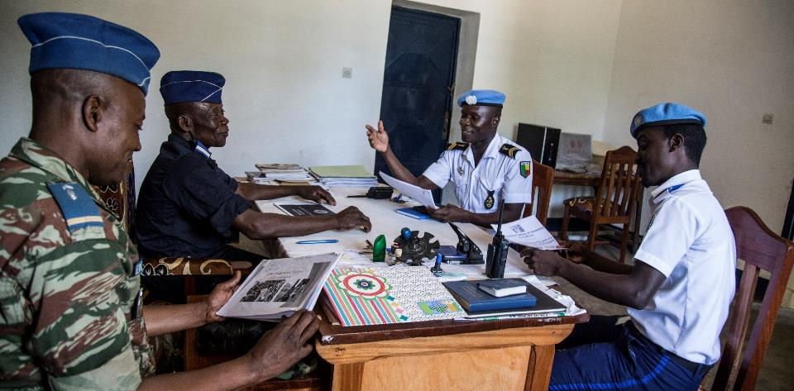
MMA in UN Peace Operations

Slide 17
Learning Objectives
Learners will be able to:
  Explain the role of a mentor/adviser in Peace Operations
  Discuss the basic principles of MMA
  Outline the MMA process

Slide 18
Role of a Mentor/Advisor in Peace Operations
From “Doer” | To “Mentor/Adviser”
Decision-making authority | No formal authority
Established reputation | Potential inherited bad reputation
Selected as mentor/adviser based on experience or trusted relationship | Appointed to mentee/advisee without prior relationship
Familiarity with professional context & environment | No or little cultural compass
Responsibility & accountability to performance | No formal or measured responsibility for impact
“Doer” | Helper, supporter, partner, peer, resource
Talker/communicator of messages/ results | Listener, identifier of issues Elicitor of potential solutions

Slide 19
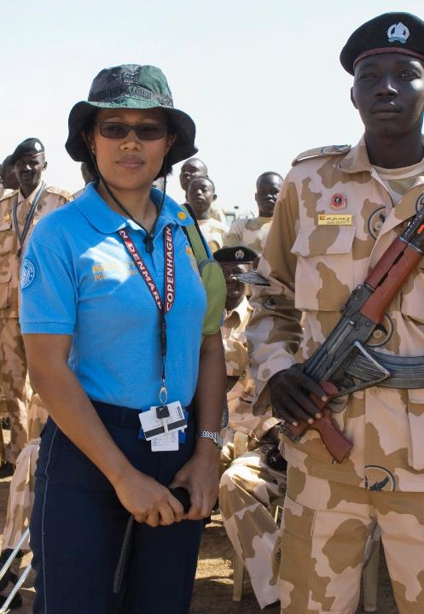
Principles of MMA
United Nations
core values
United Nations
core competencies
Local ownership

Slide 20
Success Factors for MMA
Awareness
of mission environment
Political
Legal
Economic
Administrative
Cultural
Building trust
and confidence
Respect
Patience
Flexibility
MMA skills
Communication
Knowledge Transfer
Cooperation
Coordination
Planning

Slide 21


Stages of MMA
Identification of Needs
Agreement
on Objectives
Plan of
Action and Implementation
Evaluation and Adjustment

Slide 22
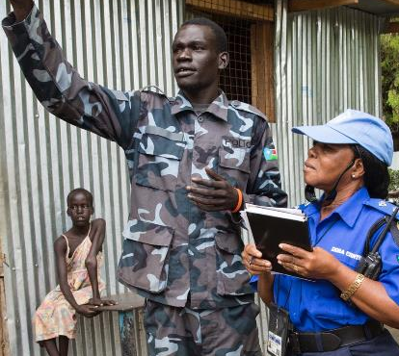
Stage 1: Identification of Needs
Based on:
Discussion with the national counterpart and other stakeholders
Information and analysis (e.g., SWOT)
Personal observation
Identification of Needs

Slide 23
Stage 2: Agreement on Objectives
Based on:
  Identified needs
  National ownership
  SMART Objectives
Agreement
on Objectives
Specific
Measurable
Action-oriented
Realistic
Time-Bound

Slide 24
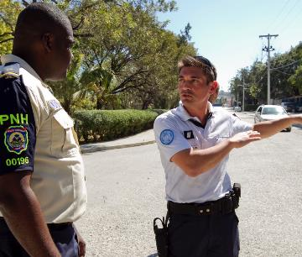
Stage 3: Plan of Action and Implementation
Plan of
Action and Implementation
Plan Should Include
Objectives
Budget / Resources
Activities
Indicators of Performance

Slide 25
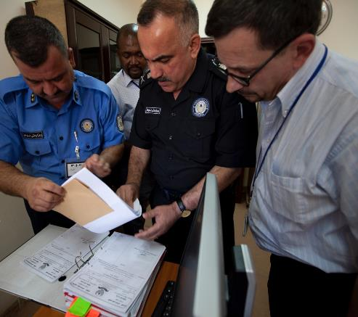
Stage 4:
Evaluation and Adjustment
Structured monitoring of progress
Observation and documentation of relevant incidents and situations
Feedback based on observations
Evaluation and Adjustment

Slide 26
Summary of Key Messages
MMA Principles are based on: United Nations core values, United Nations core competencies and local ownership.
Success of MMA is based on: awareness of mission environment, building trust and having the appropriate MMA skills.
MMA has four stages: Identification of Needs, Agreement on Objectives, Plan of Action and Implementation, and Evaluation and Adjustment
25

Slide 27
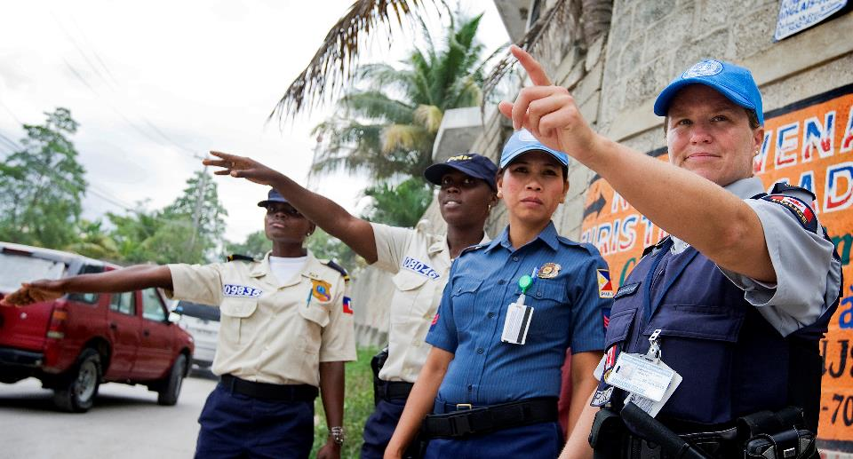
Challenges Related to MMA

Slide 28
Learning Objectives
Identify challenges related to MMA
Illustrate approaches to effectively apply MMA towards mandate implementation

Slide 29
Learning Activity 8.2:
MMA Challenges and Solutions
Instructions
Read the scenario
Discuss the questions in your groups
  Identify the MMA challenges and brainstorm possible solutions
  Record both on different moderation cards
Present the identified challenges and solutions to the plenary
Participate in plenary reflections

Slide 30
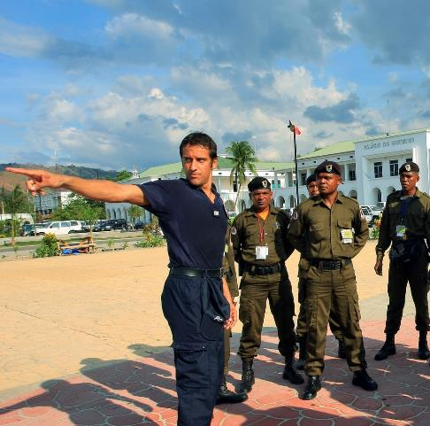
Debrief: Challenges in MMA
Understanding and recognizing the challenges regarding:
Motivation
Resistance
Culture
Cross-cultural communication
Working through an interpreter

Slide 31
Debrief:
Overcoming MMA Challenges
Explaining the mandate and roles
Cross-cultural awareness
Building trust
Applying adult learning principles
Being patient
Active listening
Negotiation
Constructive feedback
Proper reporting and handover
Advancing United Nations’ way of policing

Slide 32

Benchmarks Towards Mandate Implementation
In accordance with United Nations standards, every police or other law enforcement agency should be representative of and responsive and accountable to the communities it serves.
All United Nations Police assistance must aim at helping the host-State achieve such state of policing.
~MMA Manual 2017, 4.1.4.

Slide 33
Summary of Key Messages
Monitors, Mentors and Advisers need to understand and recognise the challenges they might face in the field.
To become an effective mentor or adviser you need to overcome these challenges.
All United Nations Police assistance must aim at helping the host-State achieve a state of policing where every police or other law enforcement agency should be representative of and responsive and accountable to the communities it serves.
32

Slide 34
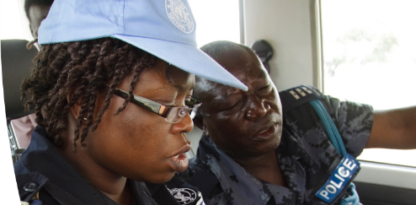
MMA Reporting
and Documentation

Slide 35
Learning Objective
  Identify the elements of MMA reporting and documentation

Slide 36
Round Robin Group Discussion: MMA Documentation
Instructions
Discuss your assigned question with your group
Record your ideas on the flipchart
After 5 minutes move to the next question, discuss and add your ideas to the flipchart
Participate in the plenary discussion and debrief

Slide 37
MMA Documentation
  Handover notes
  Capacity-building strategic plan
  Monitoring checklist
  Mapping of capacity and capability gaps
  Mentoring and advising progress reports/logbook
  End-of-mission report

Slide 38
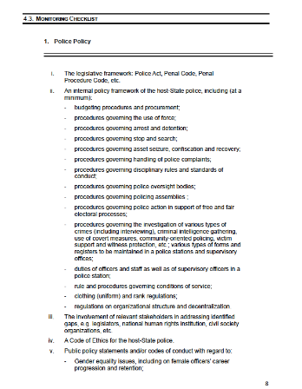
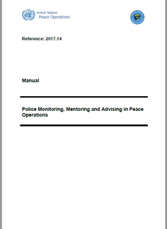
MMA Manual: Monitoring Checklist

Slide 39
Summary of Key Messages
Every mentor/adviser leaving the mission, in addition to the end-of-mission report, should prepare a well-structured report to the mentoring and advising coordinator and detailed handover notes for his or her successor.
The MMA Manual (2017) contains a monitoring and reporting checklist. Police components are required to use this checklist for monitoring reporting on police capacity-building and development activities.

Slide 40
Questions

