Slide 1
Protection of Civilians by UN Police

Slide 2
Aim
To present the role of the United Nations Police in Protection of Civilians (POC) as highlighted in the POC Guidelines

Slide 3
Relevance
POC is an essential task for every IPO in United Nations Peacekeeping Operations. This is affirmed by Security Council Resolution 2185 (2014) which is a core resolution for United Nations Police.

Slide 4
Learning Objectives
Explain the protection role of United Nations Police in POC
Identify IPO activities in the three tiers and each of the four operational phases
Illustrate the integrated approach in POC
Explain the mechanism of cooperation in POC operations that include civilian and military components

Slide 5
Lesson Overview
Mission and role of UNPOL in POC
The three tiers approach and role of UNPOL
Four operational phases and UNPOL
Cooperation with other mission components

Slide 6

Guidelines “United Nations Police in Protection of Civilians”
1
2
3
Assist UNPOL in implementing POC mandates
Apply to Police components of United Nations Peace Operations with POC mandates
Reflected in
Pre-deployment training modules
Induction and in- mission training

Slide 7
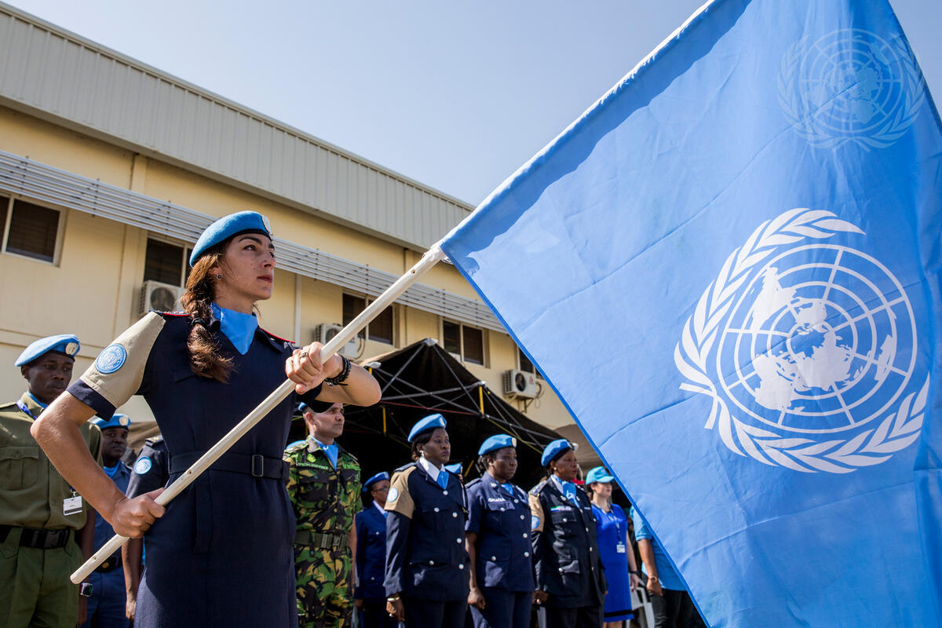
Guidelines “United Nations Police in Protection of Civilians”
Aimed at
  HOPC and SMT
  HQ & Mission planners
  All UNPOL personnel
  Civilian experts

Slide 8
UN Police and POC
Active duty to protect
Prioritise POC activities among mandated tasks
Protect and respect human rights
Respect and promote the primary responsibility of host governments to protect civilians
Enhance peace and security

Slide 9
Protection in Domestic and Peace Operations Settings
Protection is a central policing task in domestic settings
UN Police tasks differ from policing in a domestic setting
UN Police have different authority and resources
In Peace Operations, physical threats to civilians may be different

Slide 10
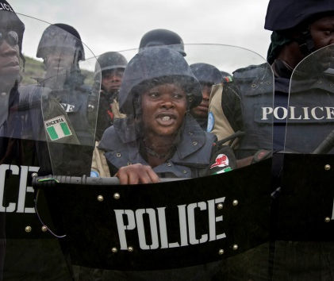
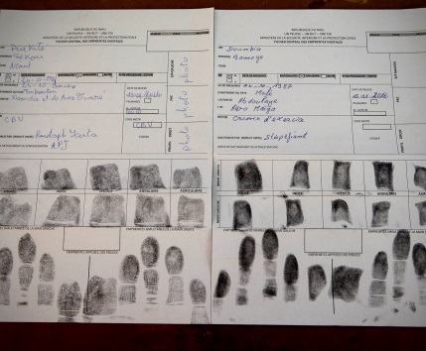
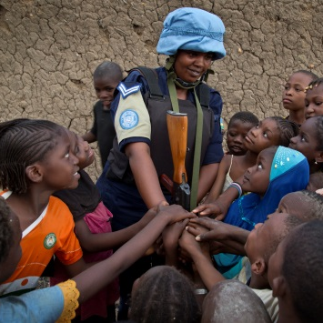
Key Activities of United Nations Police in POC
Support to host-State police
Conduct Community-oriented Policing
Provide early warning
Foster public order and security

Slide 11
Head of UN Police Component
Command responsibility
Contribute to the development and implementation of POC strategy
Issuance of operational plans (OPLAN) and directives
Ensure common understanding of Directive on the Use of Force (DUF)
Ensure training delivery

Slide 12
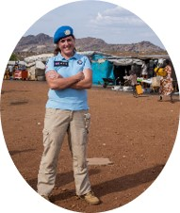
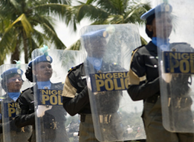
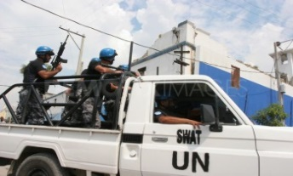
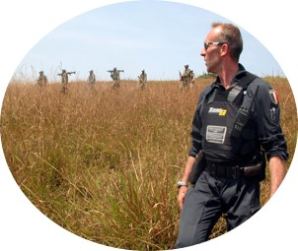
UN Police Capacities for POC
Individual Police Officers
Formed Police Units
Specialized Police Teams
Civilian Professionals

Slide 13
The Three-Tier Approach to POC
Tier I
Protection through dialogue and engagement
Tier II
Provision of physical protection
Tier III
Establishment of a protective environment
No inherent hierarchy or sequencing between the tiers

Slide 14

Tier I – Protection through Dialogue and Engagement
Examples of UNPOL activities
Information gathering and analysis in support of political processes
Liaise and advocate for protection of civilians with host-State authorities
Strengthen community-oriented policing approaches and promote engagement with communities
Record and share allegations of violations of human rights

Slide 15
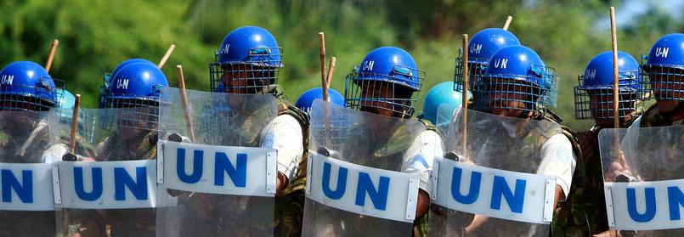
Tier II –
Provision of Physical Protection
Activities involving the show or use of force to prevent, deter, pre-empt and respond
Formed Police Units play a critical role
FPU role in POC should be reflected in the Police CONOPS and OPLAN

Slide 16
Tier II – Provision of Physical Protection
IPOs support the provision of physical protection by:
Contributing to the identification of areas and situations for which physical protection measures undertaken by FPUs should be prioritised
Working closely with human rights components and civil affairs

Slide 17
Tier II – Examples of UN Police Activities to Provide Physical Protection (IPOs)
Monitor, gather and share information
Conduct risk and threat assessments considering the vulnerabilities of civilians
Patrol
Display presence at refugee and/or IDP camps
Monitor human rights
Maintain a robust posture and/or high-profile presence in areas of potential threat

Slide 18
Tier II – Examples of UN Police Activities to Provide Physical Protection (FPUs)
Deploy proactively to strategic locations to deter attacks on civilians
Provide protective defensive positions around civilian settlements
Prevent, pre-empt and respond to physical threats
Stop and detain as set forth in the mandate and DUF

Slide 19

Tier III – Establishment of a Protective Environment
Building the capacity
and willingness of the host-State police and other law enforcement services to protect civilians
Reform, restructure and rebuild host-State police
Human rights monitoring and investigations
Support to the re-establishment of judicial and corrections systems
Support child protection and SGBV activities

Slide 20
Focus on Capacity-Building
Extend state authority
Build capacity of the justice chain
Support the host-State police
Rigorous application of HRDDP and SGF
Increase host-State police contributions to the establishment of a protective environment

Slide 21
The Three-Tier Approach:
Operational Phases
The three tiers of POC actions are implemented along four operational phases:
Tier I
Tier II
Tier III
Prevention
Pre-emption
Response
Consolidation
Phases are not necessarily sequential and can be simultaneous or independent

Slide 22
Phases of Response
Proactive
Plans and actions to reduce the risk of violence against civilians
Reactive
Plans and actions
to reduce the effects
of violence
Prevention
Pre-emption
Response
Consolidation

Slide 23
Learning Activity 9.1
Instructions
Consider the four operational phases and identify UNPOL tasks for each phase
Next, allocate tasks to FPUs, IPOs and/or other UNPOL elements
Response Phase | UNPOL Tasks | Who?
Prevention
Pre-emption
Response
Consolidation
22

Slide 24
Activity Debrief: Phases of Response
Prevention
Pre-emption
Response
Consolidation
For instance
Visible presence, patrols, FPU deployments
Identify Early Warning of Human Rights Violations
Mitigate community conflicts that could escalate into physical violations
Sensitise host-State police to HR and IHL standards
Promote accountability mechanisms for internal/external oversight

Slide 25
Activity Debrief: Phases of Response
Prevention
Pre-emption
Response
Consolidation
For instance
Increased patrolling either jointly with host-State police or unilaterally
Proactive engagement, advocacy with and support to host-State police whose elements have perpetrated violence against civilians
Political pressure; intensified communication with armed actors and potential parties to the conflict
Human rights monitoring and reporting

Slide 26
Activity Debrief: Phases of Response
Prevention
Pre-emption
Response
Consolidation
For instance
Direct action by FPUs to protect civilians as set forth in the DUF
Provide direct physical security to stop aggressors and secure civilians’ movement to more stable areas
Mobilise, persuade and support host-State police in extending their presence and ensuring rule of law and public order in affected areas
Collect, register and preserve evidence of crimes against humanity and other serious crimes
Human rights monitoring and reporting

Slide 27
Activity Debrief: Phases of Response
Prevention
Pre-emption
Response
Consolidation
For instance
Mediation and stabilisation post-crisis
Restoration of the rule of law and prevent recurrence of violence
Collection of evidence and human rights investigations
Support delivery of humanitarian aid

Slide 28
Planning for UNPOL
Based on joint threat assessment
Location and size of vulnerable groups
Capacity and intent of spoilers
Capacity and willingness of host-State police to protect civilians

Slide 29
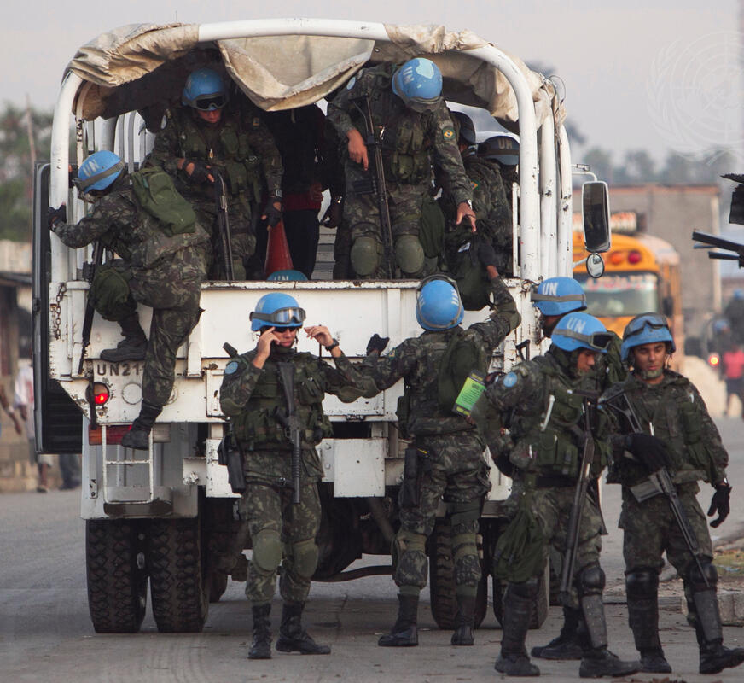
Police - Military Cooperation Overview
Police/military joint operations should be an exception
Different Techniques, Tactics and Procedures (TTPs) could create difficulties during operations

Slide 30
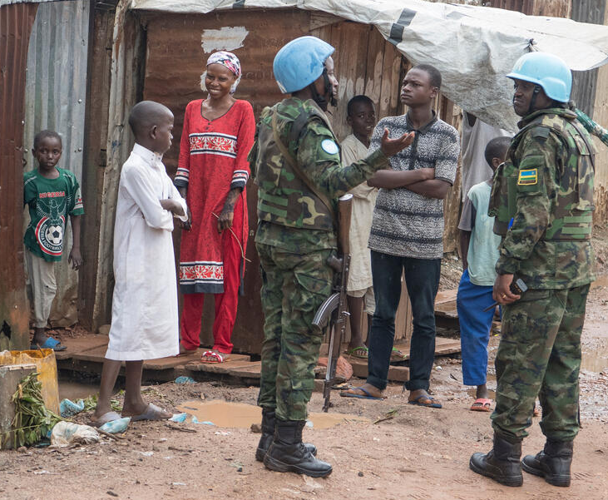
Key Factors for Mutually Supportive Operations
Understand and respect each component’s:
Mission
Independent role
Means and capabilities

Slide 31
Key Partners
POC-Adviser/Women Protection /Child Protection
Humanitarian Country Team (HCT)
Justice and Corrections
Mine Action
Civil Affairs
JOC/JMAC
Public Information
Human Rights

Slide 32
Learning Activity 9.2
Instructions
Work in groups.
Identify areas for cooperation among different mission components
Time: 15 Minutes
Brainstorming: 9 minutes
Discussions: 6 minutes

Slide 33
Summary of Key Messages
UN Police prioritise POC activities
among other mandated tasks.
The POC Guidelines for UN Police provide
detailed guidance for strategic,
operational and tactical levels.
UN Police have an active duty to protect.
Close cooperation with other mission
components and local authorities is essential.

Slide 34
Questions

