Slide 1
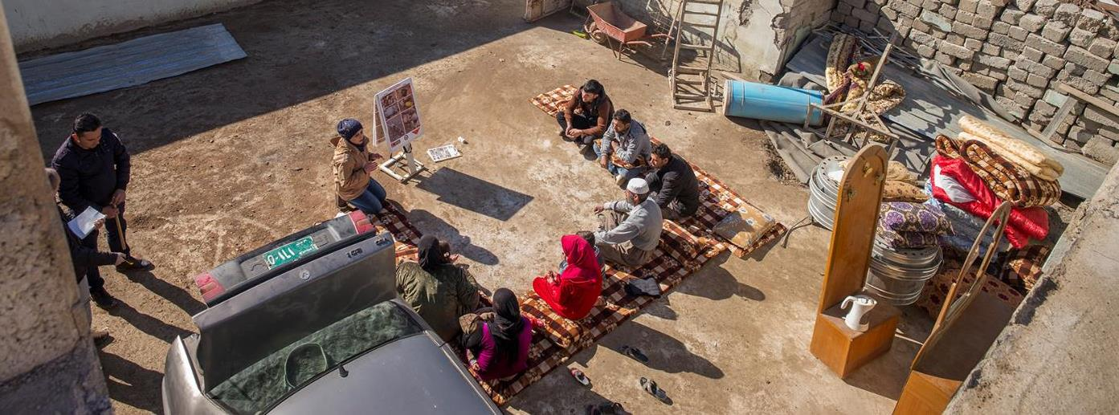

New Technologies and Methodologies for EORE in Challenging Contexts
Photo © Sean Sutton/MAG
Photo © Sean Sutton/MAG

Slide 2
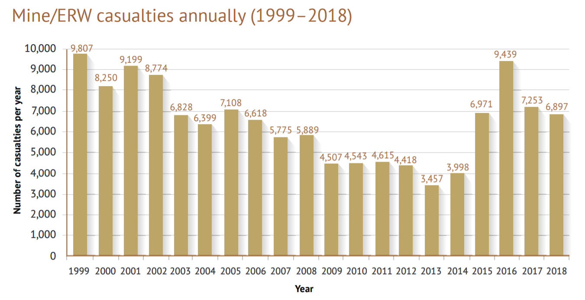
Why Risk Education Matters
Source: Landmine and Cluster Munition Monitor 2019

Slide 3
risk education
e
is
evolv
ing
must

Slide 4
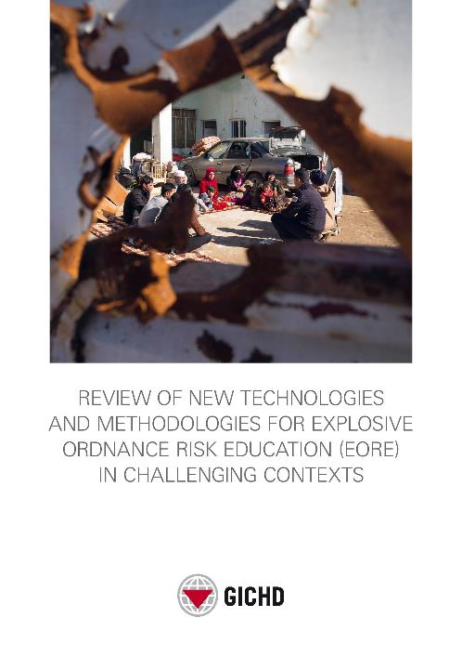
www.eore.org
Download the report
Interactive flipbook
Resource library

Slide 5
Going Digital
Digging Deeper

Slide 6

Going Digital
TRUST
TWO-WAY
COMPLEMENTARY

Slide 7


Digging Deeper
Behaviour Change

Slide 8
Conclusion
Reach
Knowledge Retention
Behaviour Change
More resources & more space required to explore innovations and build from the bottom up

Slide 9





gichd.org
m.laruelle@gichd.org

